Slide 1
LIS512 lecture 12
LCC basics
  Thomas Krichel
  2010-04-21

Slide 2
today
Introduction
History of LCC
Structure of LCC
The anatomy of the call number

Slide 3
What is classification?
Classification in general
  The placing of subjects into categories
  Provides a system for organizing, categorizing knowledge
  Roots of current classification systems go back to Aristotle’s classical theory of categories
Notes:
Aristotle: things are placed into the same category based on what they have in common – category is like an abstract container with things either inside or outside the container.
[NOTE: Arlene Taylor’s The Organization of Information has an excellent discussion of classification theory and overview of classification schemes.]

Slide 4
Classification of books
If you were organizing a collection of books, how might you arrange them?
  Author’s last name
  Title
  Subject
  Size
  Color
  Hardback vs. paperback
  Publisher
“Public orderings”
Notes:
Many people organize their personal libraries – some approaches listed here.
Henry Petroski’s The book on the bookshelf includes an appendix called “Order, Order” in which he lists different approaches to arrangement of personal libraries. Those listed here he calls “public orderings” because the principle behind a grouping would be more or less evident to someone looking at the shelves.
ANIMATION: click to bring in text box

Slide 5
Classification of books (2)
Read and unread books
Order of acquisition
Provenance
Sentimental value
According to a classification system such as LCC or DDC
“Private orderings”
Notes:
ANIMATION: click to bring in text box
The top four approaches here are “private orderings” – the arrangement would be very difficult for anyone but the owner of the library to discern. Petroski lists more in his book, such as arrangement by ISBN, by price, and by opening sentence.
Ask attendees if they have additional personal organization schemes?

Slide 6
Classification in libraries
Use of a systematic scheme for the arrangement of books and other materials
The purpose is the co-locate items on the same topic next to each on the shelf.
Contrary to subject headings, classification is pretty useless in digital libraries.
Notes:
In American libraries, classification has been used primarily as a shelving device, but it has great potential as an information retrieval tool as well.

Slide 7
Some early developers & systems
Francis Bacon
  1605, published his outline of knowledge
Jean Le Rond d’Alembert
  1751, published ideas on how Diderot’s Encyclopédie might be arranged
Thomas Jefferson
  System based on Bacon and d’Alembert
Melvil Dewey
  Dewey Decimal Classification
Charles Ammi Cutter
  Expansive Classification
Notes:
Some of the early developers of classification schemes – names may be familiar.

Slide 8
Basic terminology
Classify:
To categorize, in order to arrange books on the shelves according to subject, using a classification system
Classification schedules:
The books (or files) that contain class numbers
Notation:
The system of symbols used to represent the classes in a classification system

Slide 9
General process for classification
Analyze the subject content of the work. Summarize the primary subject focus of the work as a whole
Go to the classification schedules and determine where the item should be placed within that scheme
Assign the class number
As appropriate for the scheme, add additional elements to the class number
14
Notes:
1st bullet: we’re not covering the formulation of subject headings in this workshop, and this is certainly not a necessary step in classification. In practical terms, however, many catalogers follow this sequence of steps and assign subject headings before classifying an item. Copy catalogers may often work with copy that has subject headings but requires classification.

Slide 10
Types of classification schemes
Hierarchical
  Subjects are divided hierarchically, from general to specific
Enumerative
  All aspects of a subject are explicitly provided for in the schedules
Analytico-synthetic
  Commonly occurring concepts (place, form, etc.) are listed once and notation is used to build or synthesize numbers
Faceted
  Does not assign fixed numbers to subjects, but combines facets of a subject in a composite number
Notes:
Now we’ll talk briefly about types of classification schemes and some of the most common schemes in U.S. libraries.
[NOTE: this slide and the next are meant to raise awareness of other approaches to classification. Depending on the audience, the instructor may wish to spend little (or no) time on these concepts. Detail provided in the notes is primarily for the instructor’s benefit and not necessarily intended to be covered in depth with the attendees.]
ANIMATION: click for each bullet
1st bullet: Most classification schemes are hierarchical, creating categories from general to specific. [Colon Classification is an exception – mentioned later.]
2nd bullet: Enumerative classification systems (such as LCC) often include lengthy lists of compound and complex subjects. Terms for aspects such as place, period, and form appear repeatedly throughout the schedules.
3rd bullet: Dewey Decimal Classification is one example of an analytico-synthetic scheme.
4th bullet: Colon Classification is an example of a faceted scheme -- we’ll see an example of a Colon Classification number in slide 23. Many people are hearing about faceted displays in new interfaces to library catalogs – these typically make use of subject subdivisions to allow users to narrow a search by form, geographic treatment, or chronological period. Faceted classification is quite different.
[NOTE: a classification scheme can fit more than one of these types – for example, LCC is hierarchical and very enumerative. DDC is hierarchical and enumerative (though much less so than LCC) and has analytico-synthetic features.]
[NOTE: see Arlene Taylor’s The Organization of Information, p. 176-181, for an excellent explanation of these concepts.]

Slide 11
Selected classification schemes
Most common in U.S. libraries:
  Dewey Decimal Classification (DDC)
  Library of Congress Classification (LCC)
  Superintendent of Documents (SuDocs)
  National Library of Medicine (NLM)
More common outside U.S.:
  Universal Decimal Classification (UDC)
  Colon Classification (CC)
Notes:
We’ll focus on LCC for the rest of the workshop, but first note that there are a number of different classification schemes used in libraries.
There is more information on these classification schemes in your appendix.

Slide 12
Dewey Decimal Classification
(DDC)
Developed by Melvil Dewey in 1876
Widely used by public and school libraries in the U.S.
Used in more than 135 countries
Translated into over 30 languages
DDC now owned by OCLC. Access is expensive.
Notes:
Currently in 22nd edition
One reason DDC has been widely adapted internationally is that it is a numeric system (as opposed to alphanumeric)

Slide 13
Library of Congress Classification (LCC)
Designed to arrange LC’s collections
Widely used in academic libraries
Enumerative – more is spelled out in the schedules
Larger – over 40 separate volumes
Economical notation (shorter numbers)
Notes:
Just a few points about features of LCC in comparison to DDC – much more later

Slide 14
Considerations in choosing a classification scheme
Focus of the collection to be classified
  General or specialized?
Maintenance of the schedules
  Revised to accommodate new subjects?
  Do revisions require reclassification?
Cost
  Availability of catalog copy using the scheme
  Cost of the schedules, print and/or electronic
Personnel issues
  Professional/paraprofessional staff, students, volunteers?

Slide 15
Advantages to using LCC vs. DDC?
Widely available on catalog copy with complete call number
Relatively unlimited expansion, not requiring wholesale revision
Shorter numbers
Cooperative opportunity to introduce new numbers
Notes:
1st bullet: Dewey numbers on LC copy do not include pre-assigned book number (trainers be aware that the concept of book numbers has not yet been explained)

Slide 16
Disadvantages of using LCC vs. DDC?
Lack of consistency among schedules
Too large for an individual to fully master
No single index
Too complex for children’s collections
Based on literary warrant from LC’s collections
Parts of its organization still reflect 19th/early 20th century worldview
22
Notes:
3rd bullet: Although there is no single index, Classification Web serves as an overall index

Slide 17
Summary
Classification provides a system for organizing and categorizing knowledge
A number of different systems can be used for classification in libraries
Classification of information resources is important:
  As a shelving/location device
  For collocation of resources
  To facilitate discovery of resources, whether physical or electronic
32

Slide 18
Purpose of LCC
Developed by the Library of Congress for organizing its own collections
Adopted by other libraries, particularly academic and research libraries
Initially a shelf-location device
A useful retrieval tool in online systems
Limited use as a tool for organizing web resources
3
Notes:
The Library of Congress Classification (LCC) is the system used by the Library of Congress for organizing its own collections. First articulated more than one hundred years ago, it has been updated continuously ever since.
Although it was designed to accommodate the Library's own extensive research collections, many other large American academic and research libraries have adopted the system for their own use; so have many general libraries. Many foreign libraries use the system as well.
Although in American libraries classification has been used primarily as a shelving and location device, offering limited subject access through shelf browsing in the manual environment, it has been proven a useful retrieval tool also in online systems that offer sophisticated browsing and searching functions (as we saw in the previous session). And, to a limited extent, LCC is also being used as a tool for organizing Web resources.

Slide 19
Brief history (1)
The Library of Congress established in 1800 when the American legislature was preparing to move from Philadelphia to the new capital city of Washington, D.C.
Section five of "An Act to Make Further Provision for the Removal and Accommodation of the Government of the United States," signed by President John Adams on April 24, 1800, provided a sum of $5,000 "for the purchase of such books as may be necessary for the use of Congress and the said city of Washington, and for fitting up a suitable apartment for containing them.
Notes:
ANIMATION: click to bring in each bullet
The Library of Congress was established in 1800 when the American legislature was preparing to move from Philadelphia to the new capital city of Washington, D.C. Before that time, members of the U.S. Congress used libraries in New York and Philadelphia, namely, the New York Society Library and the Library Company of Philadelphia.
In the legislation that authorized the move of the nation’s capital to Washington, DC, signed by President John Adams on April 24, 1800, a sum of $5,000 was provided "for the purchase of such books as may be necessary for the use of Congress and the said city of Washington, and for fitting up a suitable apartment for containing them."[1]
[1]John Y. Cole, ed., The Library of Congress in Perspective: A Volume Based on the Reports of the 1976 Librarian's Task Force and Advisory Groups (New York: R.R. Bowker, 1978), 5.

Slide 20
Brief history (2)
Early on, books were grouped by size and, within size groups, by accession number, as reflected in the first (1802) and the second (1804) LC catalogs
The first recorded change in the arrangement of the collection reflected in the Library's third catalog (1808), showing added categories for special bibliographic forms such as plans, state laws, legislative and executive reports and papers, financial reports, and gazettes.
5
Notes:
Early on, books at LC were organized by size and, within each size group, by accession number. The first catalog was issued by the Library in 1802, and the second, which shows the same arrangement, in 1804.
The first recorded change in the arrangement of the collection appears in the Library's third catalog, issued in 1808, which shows added categories for special bibliographic forms such as legal documents and executive papers.[1]
[1]Leo E. LaMontagne, American Library Classification with Special Reference to the Library of Congress (Hamden, CT: Shoe String Press, 1961), 44-45.

Slide 21
Brief history (3)
Burning of the US Capitol and the Library of Congress’s collection in 1814 by British soldiers
Purchase of Thomas Jefferson’s personal library of 6,487 books, classified by Jefferson’s own system
Library of Congress retaining Jefferson’s classification system
6
Notes:
On the night of August 24, 1814, during the War of 1812, British soldiers set fire to the Capitol, and most of the Library of Congress’s collection was destroyed.
Some time after, Thomas Jefferson offered to sell Congress his personal library; subsequently, in 1815, the Congress voted $23,950 to purchase Jefferson’s personal library of 6,487 books. The books arrived already classified by Jefferson’s own system.
The Library adopted this system and used it with some modifications until the end of the nineteenth century.

Slide 22
Brief history (4)
Expansion of the Library's collection from seven thousand books to nearly one million by 1890s
LC’s move to a new building in 1897
Contemplation of a new classification scheme for the Library
Decision for its development in 1900
Provisional outline proposed in 1901
7
Notes:
By the 1890s the Library's collection had grown from seven thousand books to nearly one million, and it became obvious that the Jeffersonian system was no longer adequate.
The move to the new library building in 1897 made this fact painfully apparent.
Contemplation of a new classification scheme for the Library began in the same year, and the decision for its development was made in 1900. A provisional outline was drawn up in 1901.

Slide 23
Brief history (5)
James C. M. Hanson, Head of the Catalogue Division, and Charles Martel, the newly appointed Chief Classifier, responsible for new classification scheme
Use of Cutter's Expansive Classification as a guide for the order of classes in the broad outline of the LC Classification
Considerable changes made in notation
Notes:
James C. M. Hanson, Head of the Catalogue Division, and Charles Martel, the newly appointed Chief Classifier, were responsible for developing the new scheme
Hanson and Martel concluded that the new classification should be based on Cutter's Expansive Classification as a guide for the order of classes, but that considerable changes in notation would be necessary.

Slide 24
Order of publication of LCC schedules
1901 E-F History: America
(Western Hemisphere)
1902 Z Bibliography. Library science
Additional schedules were developed throughout the twentieth century
Development of new schedules is ongoing
Notes:
Although it often is assumed that the Library of Congress Classification schedules were developed and published in a comprehensive and logical order, that actually is not the case.
Class Z (Bibliography and Library Science) was chosen to be the first schedule to be developed because it covered the bibliographical works necessary as the groundwork for further classification development. The next schedules, E-F (American history and geography), were developed because of their particular subject relevance. (E-F were actually published first, in 1901, followed by Z in 1902.)
For more information on the order of publication of LCC schedules, as well as some interesting historical background, refer attendees to Appendix E3.

Slide 25
Brief history (6)
Each schedule contains an entire class, a subclass, or a group of subclasses
Individual schedules of LCC developed and maintained by subject experts
Conversion from print to electronic format beginning in early 1990s
Conversion using the USMARC (now called MARC 21) Classification Format
Notes:
Each schedule of LCC contains an entire class, a subclass, or a group of subclasses
From the beginning, individual schedules of LCC have been developed and maintained by subject experts. Such experts continue to be responsible, or consulted about the need, for additions and changes. Unlike most other classification systems, LCC was not the product of one mastermind. Indeed, it has been called “a coordinated series of special classes.”
Currently, PCC libraries also contribute to the revision and updating of LCC schedules.
Until the early 1990s, LCC schedules existed mainly as a print product. Maintenance and revision remained basically manual tasks that proved to be extremely labor-intensive and time-consuming. For several reasons, the conversion to electronic form was an especially important development for LCC. That it greatly improves internal operating efficiency goes without saying. For one, it enables much more efficient production of the print schedules, which continue to be produced. More important, it facilitates revision, not only of whole schedules but also of tables and indexes.
The USMARC (now called MARC 21) Classification Format was used in the conversion.

Slide 26
General characteristics of schedules
Developed independently by different groups of subject specialists
Enumerative -- aspects of a subject explicitly provided by the schedules
Based on literary warrant
Unifying elements common to all schedules
  Physical format (print schedules)
  Internal arrangement of classes and subclasses
  Notation
  Auxiliary tables
General to specific, creating a hierarchical display
  Levels of hierarchy are indicated by indention
Notes:
ANIMATION: click for each bullet
“Developed independently” -- often called a “series of special classifications”; each schedule stands on its own with differences peculiar to the discipline(s) it represents. Despite the uniqueness of each schedule, they do have a number of common, unifying characteristics.
“Enumerative” -- Only those classifications listed in the schedules, or explicitly allowed by instructional notes (e.g., by topic, A-Z), are allowed -- if it’s not in the schedule, or explicitly allowed by instructions, it can’t be used. DDC, by contrast, allows classifiers to refine an enumerated subject by the addition of standard subdivisions.
“Physical format” refers to the print version.
Levels of the hierarchy are indicated by indentions.

Slide 27
Broad outline of LCC
General Works (A)
Humanistic Disciplines & Social Sciences (B-P)
  Philosophy, Religion, History, Geography Anthropology, Social Sciences, Music, Fine Arts, Language & Literature
Natural Sciences & Technology (Q-V)
  Math, Physical & Biological Sciences, Medicine, Agriculture, Technology, Military & Naval Sciences
Bibliography & Library Science (Z)
Notes:
A look at LCC as a whole.

Slide 28
Main classes (1)
Entire field of knowledge divided into main classes
Roughly equal to academic disciplines or areas of study
Denoted by single capital letters
Notes:
The first level of LCC includes the 21 main classes.
Main classes are listed on the next slide.

Slide 29
Main classes (2)
A General works
B Philosophy, Psychology, Religion
C History - Auxiliary
D History - Universal & Old World
E-F History of the Americas
G Geography
H Social Sciences
J Political Science
K Law
L Education
M Music
N Fine Arts
P Language & Literature
Q Sciences
R Medicine
S Agriculture
T Technology
U Military Science
V Naval Science
Z Bibliography & Library Science
Notes:
To serve Congress with its need for an extensive collection in history and the social sciences, these disciplines received multiple classes and subclasses (as opposed to all the sciences in Q and technology in T, for example)
History -- C, D, E, F, G
Social Sciences -- H, J, K, L

Slide 30
Subclasses (1)
Represent branches of the disciplines
Denoted by double or triple capital letters
S – Agriculture
SB – Plant culture
SD – Forestry
SF – Animal culture
SH – Aquaculture. Fisheries. Angling
SK – Hunting sports
Notes:
Main classes are further divided into subclasses, which represent branches of the disciplines
Most subclasses are denoted by double capital letter, as shown here for S Agriculture.

Slide 31
Subclasses (2)
Schedules D and K use triple letters
DAW – History of Central Europe
KBP – Islamic law
KFA – Law of U.S. States, Alabama to Arkansas
Schedules E and F use only single letters
E-F History: America
E – United States (General)
F – United States local history. Canada. Latin America
Notes:
Class Z formerly used the single letter Z. Now we also have Subclass ZA, Information Resources (General).

Slide 32
Structure of LC Classification
Basic arrangement is by discipline
Various aspects of a subject are generally not grouped together, but are classed with the discipline
  Agriculture:
    technical aspects in S (Agriculture)
    agricultural economics in HD (sub-class of Economics)

Slide 33
Structure of LC Classification (2)
Railroads:
  Railroad engineering in TF (sub-class of technology)
  Organization and management of railroads in HE (transportation and communication, a sub-class of economics)
Remember: LCC separates books on the same subject by discipline
Notes:
2nd bullet: LCC separates books on the same subject by discipline: for example, books on the subject of global warming might be classed in QC if treated from the scientific perspective (meteorology/climatology); in H if treated from an economic perspective; in S if treated from an agricultural perspective (effect on crops); in RA if treated from a medical perspective (effect on health), etc.

Slide 34
Within each subclass…
Subclasses further divided to specify form, place, time & subtopics
Topical divisions often further subdivided by subtopics
Denoted by integers 1-9999, some with decimal extensions
Some subtopics may also be denoted by a Cutter number (e.g., .M84)
Notes:
Now let’s go back to the outline itself and discuss what happens in the subclasses.
3rd bullet: There are many unused numbers and letters within the schedules to allow for expansion of knowledge. This is a reflection of the “hospitality” of the schedules.
4th bullet: We’ll explain Cutter numbers thoroughly in the Elements of LC Call Numbers session – for now, here is an example of what they look like (capital letter followed by numerals)

Slide 35
Some subject divisions in
QH Biology (General)
QH359-425 Evolution
QH426-470 Genetics
QH471-489 Reproduction
QH501-531 Life
QH540-549.5 Ecology
QH573-671 Cytology
QH705-705.5 Economic biology
Notes:
Within QH Biology, these ranges of numbers are for some of the major subject divisions.
We’re going to look at the schedule using Ecology, QH540-549.5.

Slide 36
QH Biology (General)
Ecology
Class here works on general ecology and general animal ecology. For works on ecology of individual animals and groups of animals, see the animal
For human ecology see GF1+
For ecology of a particular topographic area see QH101+
For plant ecology see QK900+
Cf. BL65.E36 Ecology and religion
Cf. HX550.E25 Communism and ecology
Cf. QH546 Ecological genetics
540 Periodicals, societies, congresses, serial publications
540.3 Collected works (nonserial)
540.4 Dictionaries and encyclopedias
540.5 Philosophy
540.6 Nomenclature, terminology, notation, abbreviations
540.7 Classification
Notes:
[NOTE: Attendees have QH540+ in Appendix A. It would be useful to have that out now. They also use it for an exercise at the end of this session.]
[NOTE: continues on the next slide with QH540.8-541.15.C44]
All schedules look very similar to this, although each have their own peculiarities.
[NOTE: point out the key areas and elements in the display as you go (subclass, notes, numbers, and captions) to be sure attendees are clear on where everything is.]
The subtopic is ecology, followed by notes pertaining to the subtopic. We will discuss the different types of notes and what they mean in the following slides.
The classification begins with “540 Periodicals ...”.
Notice the indention of the captions. All of these are all subordinate to Ecology, and all are at the same level of hierarchy.

Slide 37
QH Biology (General)
Ecology
History
540.8 General works
540.83.A‑Z By region or country, A‑Z
Biography see QH26+
541 General works, treatises, and textbooks
541.13 Popular works
541.14 Juvenile works
541.142 Handbooks, tables, formulas, etc.
541.145 Addresses, essays, lectures
541.15.A‑Z Special aspects of the subject as a whole, A‑Z:
541.15.A9 Autoradiographic techniques
541.15.B54 Biological assay
541.15.B56 Biological diversity
For local, see QH84.1+
For physiographic divisions see QH84.8+
Cf. QH75+ Biological diversity conservation
Cf. QH541.15.S64 Species diversity
Cf. QK46.5.D58 Plant diversity
541.15.B84 Buffer zones
541.15.C44 Chemical ecology
Notes:
Here we see more levels in the hierarchical arrangement of topics.
Each additional indention indicates a further refinement of the topic directly above. E.g., History is divided into the subtopics “General works” and “By region or country, A-Z.”

Slide 38
Interpreting the schedules
Meaning is contained in the captions, not in the class numbers
Class numbers merely serve to order the captions
Subordination of topics is shown through indention of captions
Notes:
Class numbers are used as a means to preserve the subarrangement of disciplines throughout the various schedules. This subarrangement is maintained by the assignment of a number or numbers to a caption, adding decimal extensions when necessary.
For example: in Subclass QH Ecology, QH541 is the number assigned to the caption General works, treatises, and textbooks. The next number used in Subclass QH is QH541.13; the corresponding caption is Popular works.
Because of the decimal extension, it may appear that the number 541.13 is subordinate to 541. But in LC Classification terms, that is not the case. If we look at the caption for QH541.13, we see that it is aligned with the caption for General works, treatises, and textbooks.
In fact, it is in the captions that we find meaning and hierarchy, not in the numbers. The fact that QH541 General works, treatises, and textbooks and QH541.13 Popular works are hierarchically at the same level is identified by their alignment of their captions in the schedules, not by their corresponding numbers.
Once the need is identified to indent a new caption under any topic, the corresponding number for that caption will need to fit between the two numbers on either side of it; the choice of number is not important, as long as it files between the two. What is important is the position of the caption, with its indention showing hierarchical relationships to the captions around it. So always look at the captions in the LC schedules to identify arrangement, and think of the numbers as a locator device.

Slide 39
Interpreting the schedules (2)
Decimal numbers do not necessarily reflect subtopics of the whole number.
Decimal numbers do show that the class number was not part of the original schedule.
Parenthesized numbers are not to be used; represent class numbers that were valid in the past.
Angle brackets around a number or span of numbers indicate that LC provides this number as an option but does not use it.
Notes:
3rd bullet: there were no parenthesized numbers in the excerpt of QH540 that we just saw, but an example is coming up soon.
4th bullet: In most cases, an angle-bracketed number is accompanied by a see reference directing the user to the actual number that the Library of Congress uses or a note explaining Library of Congress practice.
[An example is <KE25-68> Law of Canada. Parliamentary publications; there is a see reference to J102 (General legislative and executive papers. Province of Canada) and J103 (General legislative and executive papers. Dominion of Canada)]

Slide 40
Notes used in schedules
Scope notes
  Explain what the classification covers
  Used when similar topics occur in different areas
  Designated by “Class here”
Explanatory “see” notes
  Used when a topic logically belongs in one division, but is covered elsewhere
  Designated by “For”
Notes:
“Prefer” notes were used in the past for explanatory “see” notes, but these have been discontinued.

Slide 41
QE GEOLOGY
Reptiles
861 General works, treatises, and textbooks
Dinosaurs
Class here works on dinosaurs in general
For works on specific orders of dinosaurs see QE862.A-Z
861.2 Periodicals, societies, congresses
861.3 Dictionaries
861.35 Computer network resources
Including the Internet
861.4 General works
861.5 Juvenile works
Notes:
ANIMATION: click to bring in each arrow
Illustrates:
Scope note
Explanatory “see” note
Full hierarchy is: Geology--Paleozoology--Chordata--Vertebrates--Reptiles

Slide 42
Notes used in schedules (2)
“See” notes
  Used to indicate topics relocated to other parts of the schedule(s)
  Former number removed or, often, parenthesized
QE GEOLOGY
Reptiles
862.A-Z Other systematic divisions, A-Z
862.C5 Chelonia. Testudinata
862.C7 Cotylosauria
862.C8 Crocodylia
(862.D4) Dicynodontia see QE862.T5
Notes:
ANIMATION: click to bring in arrow

Slide 43
Notes, cont.
“Including” notes
  Provides examples of the topics covered by a particular caption
Confer notes
  Designated by the abbreviation “Cf.”
  Indicates other aspects of the topic may be found elsewhere in the schedule(s)

Slide 44
QK BOTANY
83 Plant lore
Cf. GR780-790 Folklore
National plants. Official plants
Including state, provincial, etc. plants
84.8 General works
By region or country
85 United States
85.3.A-Z Other regions or countries, A-Z
-----------------------------------------------------------------------------
97.5 Identification
For geographic treatment see QK108-474.5
Notes:
ANIMATION: click to bring in each arrow
Illustrates:
Confer
Including
Explanatory see (“For”) note
[NOTE: Some lines of the schedule omitted, indicated by “---------------”]

Slide 45
Physical format
Each print schedule contains
  Preface
  Broad outline with subclasses
  Detailed outline with 2 or 3 levels of hierarchy
  Schedule (the actual class numbers)
  Tables
  Index
22
Notes:
These are the components of the print schedules.
The print schedules are a more effective tool for learning the classification than the electronic version, Classification Web.
The outline in each schedule gives a very useful overview of the organization of topics in the schedule.
It is easier to grasp the context of a topic within the classification by browsing the print schedule (viewing two pages in each spread) and seeing the full expansion of each topic.
When tables are applied, it is important for catalogers to understand the use of the table and how it affects the classification. In ClassWeb, it is possible to have table calculations done automatically – very useful for the experienced cataloger, but problematic for the beginner.

Slide 46
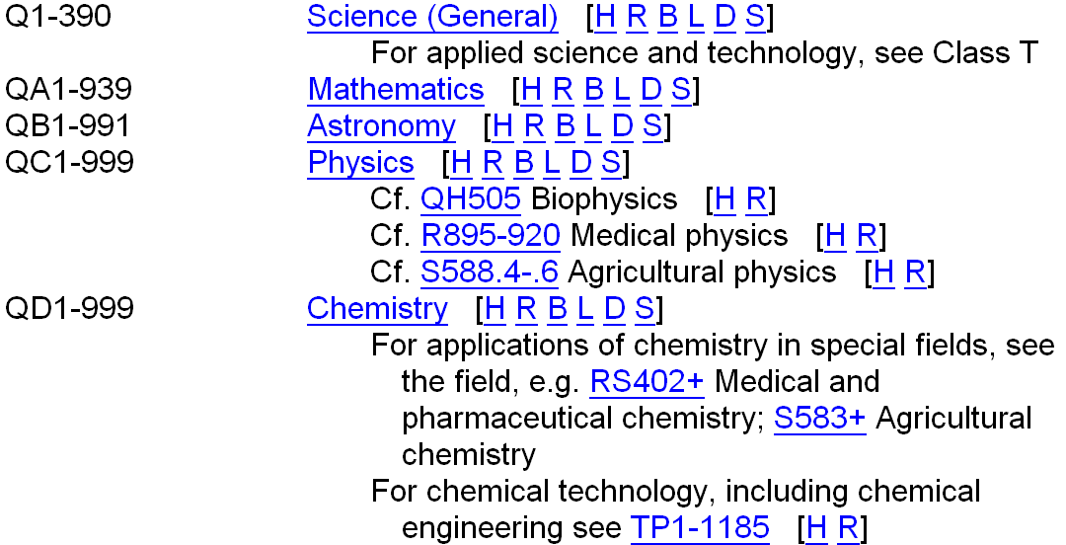
Outline view in Classification Web (1st level)
Notes:
This is a screen shot of Classification Web. We’ll explain more about ClassWeb in the Tools session coming up next.
What you are looking at is a portion of the ClassWeb outline view of Class Q. Although the initial display shows much less detail at this level than the printed schedule, the ClassWeb outline view actually incorporates the detailed outline and links to tables within the main classification, and is intended to be expanded as needed.
[NOTE: mention that the letters following the captions [H R B L D S] are features of ClassWeb that lead to additional information – more about them in the Tools session. They do not appear in the print schedules.]
[NOTE: there are three browser options in ClassWeb: Standard, Enhanced, and Hierarchy. The hierarchy browser provides this overview of the schedule and displays more specific breakdowns of the schedule with each click on a link.]

Slide 47
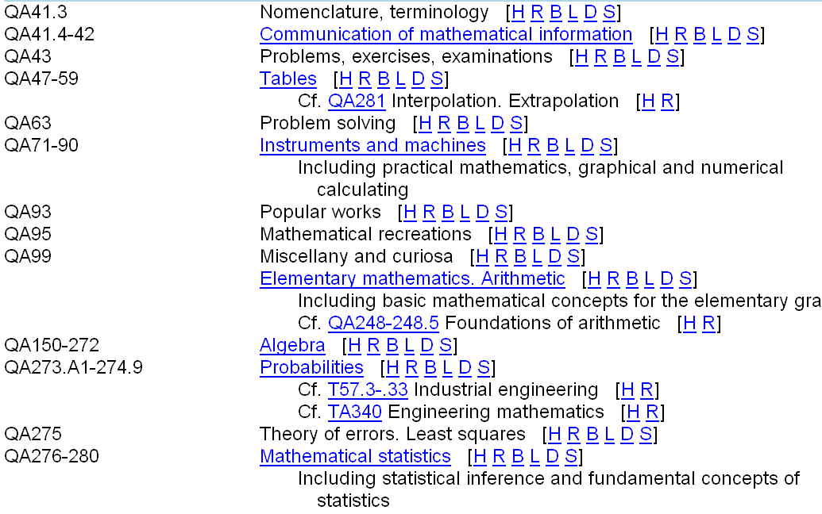
Outline view in ClassWeb (2nd level): expansion of Mathematics
Notes:
Expanding the Mathematics caption leads to a second level of the outline.
Each of the captions that is underlined and in blue text can be further expanded by clicking (these each have ranges of numbers rather than a single number as well).

Slide 48
General arrangement within subclasses and subject divisions
Form subdivisions
  Periodicals, Societies, Congresses, Directories, Collections, Dictionaries, etc.
Philosophy
History
Biography
General works
Study & teaching
Subtopics
Notes:
Now we’ll discuss the general arrangement within each subclass and subject division. This general pattern is also followed for some “special aspects of the discipline as a whole” (e.g., Philosophy; example coming up in slide 31).
Form divisions generally precede all other divisions, but exceptions do occur.
Divisions usually appear in this order; “Congresses” may be included with “Periodicals, societies, etc.” (so may some of the others).
Periodicals, societies, etc., may also each have their own number, sometimes with further geographic or language subdivisions.

Slide 49
Form subdivisions example 1
TC Hydraulic engineering
For municipal water supply see TD201-500.2
For hydraulic machinery see TJ840.A2-.A3
1 Periodicals, societies, etc.
5 Congresses
Exhibitions. Museums
6.A1 General works
6.A2-Z By region or country, A-Z
Subarrange each country by Table T4b
7 Collected works (nonserial)
9 Dictionaries and encyclopedias
12 Directories
Notes:
An example of form subdivisions under the subclass TC, Hydraulic engineering.
Some classifications may subdivide forms by place (as under Exhibitions. Museums) or language. Language divisions are usually found under periodicals and societies, as with T, Technology (next slide).

Slide 50
Form subdivisions example 2
T Technology (General)
Periodicals and societies. By language of publication
1 English
2 French
3 German
4 Other languages (not A-Z)
(5) Yearbooks see T1-4
6 Congresses
Industrial museums, etc. see T179-183
International exhibitions see T391-995
7 Collected works (nonserial)
8 Symbols and abbreviations
Dictionaries and encyclopedias
9 General works
10 Bilingual and polyglot
Notes:
Another example of forms, showing language subdivision of periodicals & societies, as well as dictionaries and encyclopedias.

Slide 51
Philosophy
Used primarily in main classes and subclasses
  Generally not found below the level of subclass
Often a single number, though may be expanded to many numbers
QH Natural history (General)
14 Authorship
14.3 Philosophy
30
Notes:
With Philosophy, we’re leaving Form subdivisions and going on to special aspects of the discipline as a whole.

Slide 52
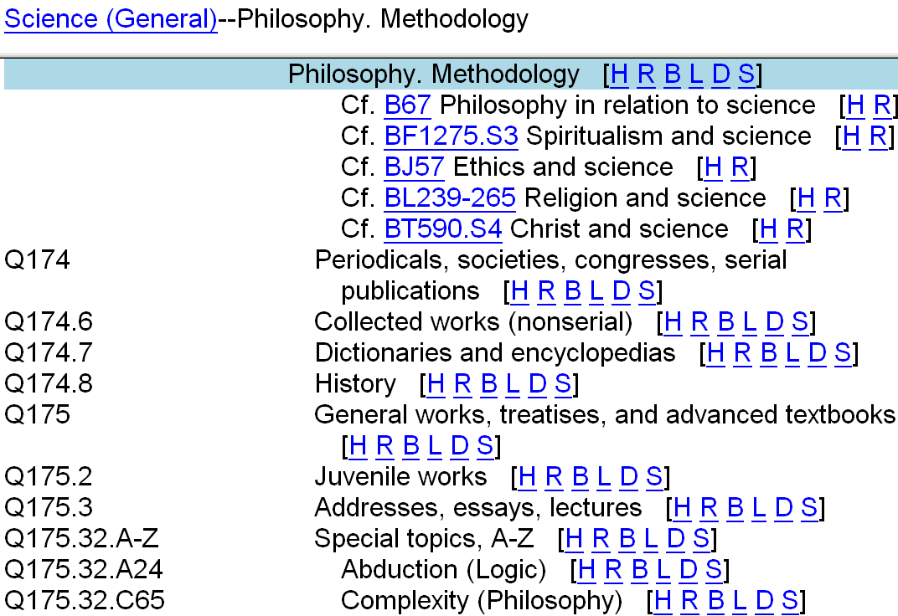
A range of numbers for Philosophy
Notes:
An example of a philosophy classification which is fairly complex -- note the additional form subdivisions found under the main subdivision “Philosophy.”
Many classifications have a single number for Philosophy, as shown on the previous slide, QH, Natural History (General):
QH14.3 Philosophy

Slide 53
History
The history of a topic is often broken down into specific time periods, e.g.,
  1945-1971
  1971-2000
  2000-
Dates refer to the period of time covered in the work being classified
Some spans written as “Through [date]” when start is undefined
Often combined with breakdown by region or country
Notes:
Each period is closed off before beginning a new span.
Each span is interpreted to mean “1945 up to, but not including, 1971”; “1971 up to, but not including, 2000”; “beginning with 2000”.
As with “Philosophy,” generally not found below the level of subclass.
If questions arise about the assignment of numbers – it is covered in the session on Principles/Assigning Numbers. Here is the relevant excerpt from SCM F320:
General rule (SCM F 320). Assign the class number that corresponds to the earliest period on which the work focuses when the work in hand covers several of the time spans listed under the topic in question. Ignore brief coverage of earlier periods that serves only to introduce the principal time period(s) being discussed.
[NOTE: there is information on date spans representing date of publication coming up, under discussion of General works]

Slide 54
History example, subdivision by place
QH Natural history (General)
14.3 Philosophy
History
15 General works
21.A‑Z By region or country, A‑Z
33
Notes:
Some history subdivisions are very complex, depending on the topic/subtopic, for example, in S, Agriculture (General), History and conditions is allotted the class numbers S419-482, with subdivisions for both time period and place.

Slide 55
history example subdivision by time period
TD Environmental technology. Sanitary engineering
History
15 General works
16 Ancient
17 Medieval
18 Modern to 1800
19 Nineteenth century
20 Twentieth century

Slide 56
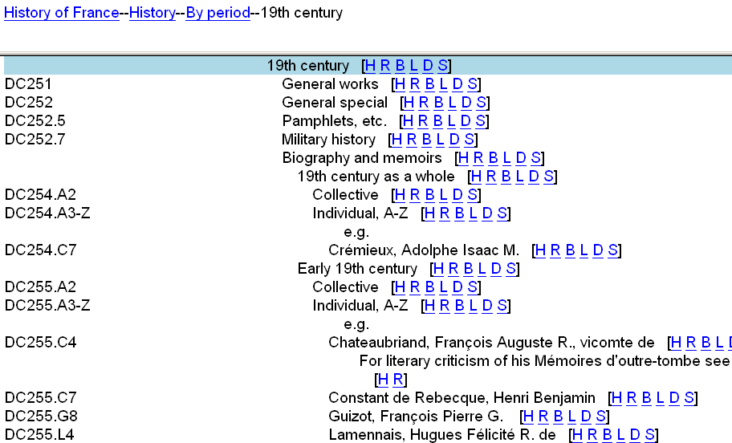
History examples (2)
Notes:
History subdivisions in the history classes are even more complex.

Slide 57
Biography
Biography numbers are generally provided under disciplines, subclasses, and broad subjects
  Separate numbers for collective & individual
QE Geology Biography
21 Collective
22.A-Z Individual, A-Z , e.g.
22.D25 Dana, James Dwight
22.L8 Lyell, Charles
22.S77 Steno, Nicolaus
35

Slide 58
General works
“General works” -- comprehensive works covering a topic
  May also be listed as “Treatises” or “General”
  Always found when there are any subtopics under a topic
Earlier schedules also included “General special” or “Special aspects of the subject as a whole”
  No new numbers of this type are being established
Other divisions in this category include “Popular works,” “Juvenile works,” “Addresses, essays, lectures”
Notes:
Earlier schedules also included “General special” or “Special aspects of the subject as a whole” separately from “General works.”
Refers specifically to special aspects of the subject as a whole, without any hierarchical divisions or branches
These divisions are no longer being added to schedules
“General works” may also be subarranged chronologically, by date of publication (example coming up).
Class numbers with the caption “Addresses, essays and lectures” (or a slight variation) sometimes appear under major topics. Works that consist of collected papers, miscellaneous articles, anthologies of readings, etc., are classed in these numbers.
In 1986, the subdivision -­Addresses, essays, lectures was discontinued in subject heading practice. That change, however, did not affect classification practice. (SCM F 300)

Slide 59
General works example 1
GV RECREATION. LEISURE
Games and amusements
Indoor games and amusements
Board games. Move games
Checkers. Draughts
1461 Periodicals. Societies. Serials
Biography
1462 Collective
1462.2.A-Z Individual, A-Z
1463 General works
Strategies and tactics
1463.5 General works
1463.7 Openings
1463.9 End games
Notes:
ANIMATION: click to bring in each arrow
A simple example, one number for General Works under Checkers.
Note that there is also a General Works number under a subtopic of Checkers, Strategies and tactics.

Slide 60
General works & date spans
Date spans used under “General works” are based on publication date rather than historical period
Through 1800
1801-1859
1860-1900
1901-
This is done to separate more recent material from older material
Dates in captions refer to imprint date
Dates do not overlap!

Slide 61
Example: dates of publication
HF COMMERCE
Business
Accounting. Bookkeeping
General works
English and American
5631 Through 1800
5633 1801-1850
5635 1851-2005
5636 2006-
Notes:
Why might it make sense to separate recent material from older material? Next slide has an example.
Remember these class numbers are not for the history of accounting and bookkeeping, but for general works on accounting and bookkeeping (often “how-to”).

Slide 62
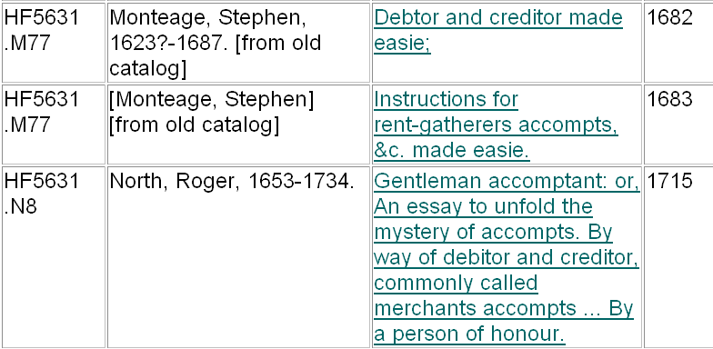
From LC’s catalog:
a few books classed in HF5631
Notes:
An example of why it makes sense to separate older material on some topics – accounting and bookkeeping practices of the 17th & 18 centuries are better NOT mixed in with contemporary works.

Slide 63
Study & teaching
Often a single number, but may receive a span of numbers
Example from QH Ecology:
Study and teaching. Research
541.2 General works
541.215 Outlines, syllabi
Special teaching methods and aids
541.22 General works
541.23 Audiovisual aids
541.235.A‑Z Other methods, A‑Z
541.235.G34 Games
Notes:
An example of study and teaching, greatly abbreviated.

Slide 64
Topics & subtopics
Comprise the bulk of individual developments or expansions of classes and subclasses
Each class, subclass & discipline developed independently
Arranged logically where possible
Alphabetical arrangement of subtopics often found, as well
Notes:
Contrast with Subject Divisions.
Topics & Subtopics are lists, sometimes further subarranged with more specific lists. The full range of form/special aspects arrangement is generally not used under topics.
Examples of logical & alphabetical arrangements follow.

Slide 65
Logical arrangement
QE GEOLOGY
840.5-882 Chordata
840.5 Cephalochordata. Tunicata. Hemichordata. Enteropneusta. Pterobranchia. Graptolinthina
841-882 Vertebrates
841 General works, treatises, and textbooks
842 Juvenile works
845 Fossil footprints
846 Fossil teeth
847 Amniotes
851-853 Fishes
861-862 Reptiles
867-868 Amphibians. Batrachia
871-875 Birds
881-882 Mammals
Notes:
A greatly abbreviated example of logical arrangement. The arrangement is from simple to complex animals. This arrangement is used in all classes that describe the relationships of living organisms (e.g., zoology, botany).
The logical arrangement of simple to complex is maintained for each systematic level from phylum (e.g., Chordata), subphylum (e.g., Vertebrates), and class (e.g., Mammals, the next hierarchical level down from vertebrates).
Classes* are arranged logically, from primitive (i.e., they appeared earlier in time) animals (or plants, in QK) to advanced animals, which appeared more recently.
Below the level of class, orders and families are arranged alphabetically. (next slide)
[*Classes here refers to science classification, not the LCC classes.]

Slide 66
Alphabetical arrangement: orders
QE GEOLOGY
881-882 Mammals
881 General works, treatises, and textbooks
882.A-Z Systematic divisions, A-Z
882.C15 Carnivora
882.C5 Cetacea
882.C8 Chiroptera
882.C84 Cimolesta
882.C9 Creodonta
882.D4 Deltatheridia
882.D45 Desmostylia
882.D6 Docodonta
882.E2 Edentata. Xenarthra
882.E86 Eupantotheria
882.H47 Herbivora
882.I5 Insectivora
Notes:
An example of alphabetical arrangement: orders are the lowest systematic division in QE.
[NOTE: QL & QK go down a level to family; also arranged alphabetically.]

Slide 67
Geographic divisions
Topics may be subdivided geographically in two ways:
  Alphabetical arrangement under one number, e.g., “By region or country, A-Z”
    It is common to assign a separate number or numbers to the U.S.
  A span of numbers, with preferred order:
    New World -- Northern Hemisphere, followed by Southern Hemisphere
    Old World -- Northern Hemisphere, followed by Southern Hemisphere; west to east
    Pacific Islands, Arctic & Antarctic regions last
    Further subdivision within each region either naturally or alphabetically
Notes:
Two ways geographic subdivisions are added to the schedules
Strictly alphabetical arrangements are generally not printed explicitly, but by the phrase, “By region or country, A-Z.”
Exception: sometimes the U.S. is singled out with its own number(s) and the phrase “By state, A-Z”; followed by “Other regions and countries, A-Z.”
Classes and subclasses generally use a span of numbers for a classified arrangement of countries by continent
“Natural order” groups countries by region, e.g., all Western European countries before Eastern European countries
Preferred order --
America
North America
United States
British N.A. Canada
Mexico
Central America
West Indies
South America
Europe
Great Britain
Continental Countries (A-Z, often)
Asia
Africa
Australia & New Zealand
Pacific Islands
Arctic regions
Antarctic regions

Slide 68
By region or country, A-Z
SF ANIMAL CULTURE
Pets
Dogs
Dog breeders, owners etc.
422.7 General works
422.73.A-Z By region or country, A-Z
Notes:
Simplest example.
Mention that there is a table (SCM G 300) that gives guidance on what to do for each country in the A-Z arrangement (covered in an upcoming session).

Slide 69
U.S. with breakdown by state
Special countries
United States
T55.7 General works
T55.72.A-W By state, A-W
T55.74.A-Z Other American countries, A-Z
T55.75.A-Z Europe. By country, A-Z
T55.76.A-Z Asia. By country, A-Z
T55.775 Australia
T55.778 New Zealand

Slide 70
U.S with breakdown by city
HT COMMUNITIES. CLASSES. RACES
City planning
166 General works
By region or country
United States
167 General works
167.2 Dept. of Housing and Urban Development
167.5.A-Z By region or state, A-Z
168.A-Z By city, A-Z
169.A-Z Other regions or countries, A-Z
Notes:
Sometimes possible to give a breakdown by city, as here with HT168, City planning by city A-Z.
There is no table for cities of the U.S.
Also note that classification here is directly to the city, not through the state.
[NOTE: instructor could give an example of a Cutter number for the city in which the workshop is held.]

Slide 71
TG BRIDGE ENGINEERING
21-127 Country divisions
21-54 America
55-95 Europe
72.P23 Paris. Alexander III Bridge
99-113.5 Asia
114 Arab countries
114.5 Islamic countries
115-119 Africa
120-120.5 Indian Ocean islands
120.7-122.7 Australasia
123-124 Pacific Islands
125-125.5 Arctic regions
126 Antarctica
126.5 Tropics
Span of numbers,
Preferred order
Notes:
Place divisions in preferred order.

Slide 72
Place divided by topic
Differs from usual LCC practice (classify by topic, sub-arrange by place)
Place divided by topic is characteristic of history schedules (D,E,F), laws of countries (KD-KWX) and some areas of the social sciences
Class or subclass divided geographically, with further subdivisions by form, topic, or period
Allows more specific enumeration of topics appropriate to each country
Notes:
Preference is to divide topics by place, as with LCSH.
2nd bullet: for example, in schedule D, each country has its own subclass with appropriate topical subdivisions, e.g., History by period, Description and travel, etc. (C, Auxiliary sciences of history, follows the usual pattern of topic subdivided by place).

Slide 73
Place divided by topic
DA HISTORY OF GREAT BRITAIN
1-3 Historiography
4 Study and teaching
10-18.2 British Empire. Commonwealth of Nations. The Commonwealth
Including Great Britain, the dominions, and the colonies.
For individual dominions and colonies, see DS-DU, F, etc.
20-690 England
700-745 Wales
750-890 Scotland
900-995 Ireland
900 Periodicals. Societies. Serials
905 Sources and documents
906 General works
Biography (Collective) see DA916
908-908.7 Historiography
909-965 History
969 Description and travel
Notes:
A greatly abbreviated example of place divided by topic.

Slide 74
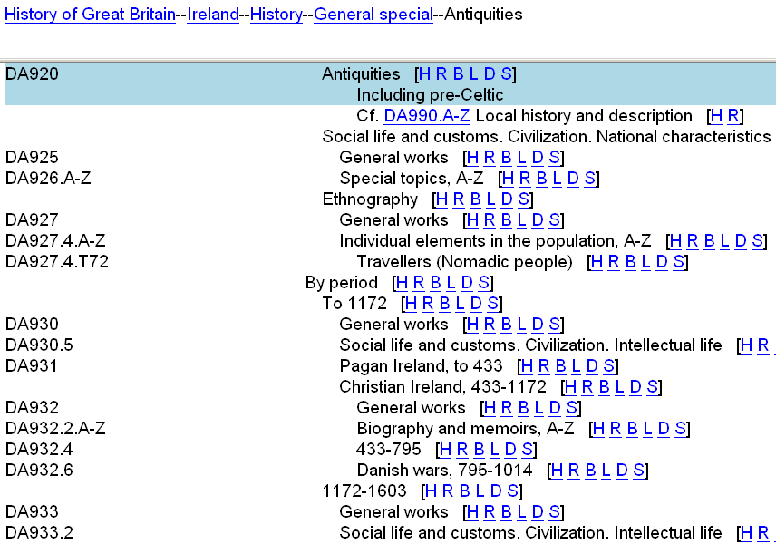
Place divided by topic
Notes:
Another example, showing more of the topical and chronological breakdown under Ireland.

Slide 75
LCC schedules: electronic
Classification Web
  http://classificationweb.net/
  Web-based tool for access to LC Classification and LC Subject Headings
  Updated daily – most up-to-date version
MARC Distribution Service (MDS) Classification
  Full set of LC Classification records in MARC 21 or MARCXML format, distributed weekly
  Includes records only; no software for display
Notes:
More on ClassWeb in following slides.
Worth emphasizing that ClassWeb is now updated daily.

Slide 76
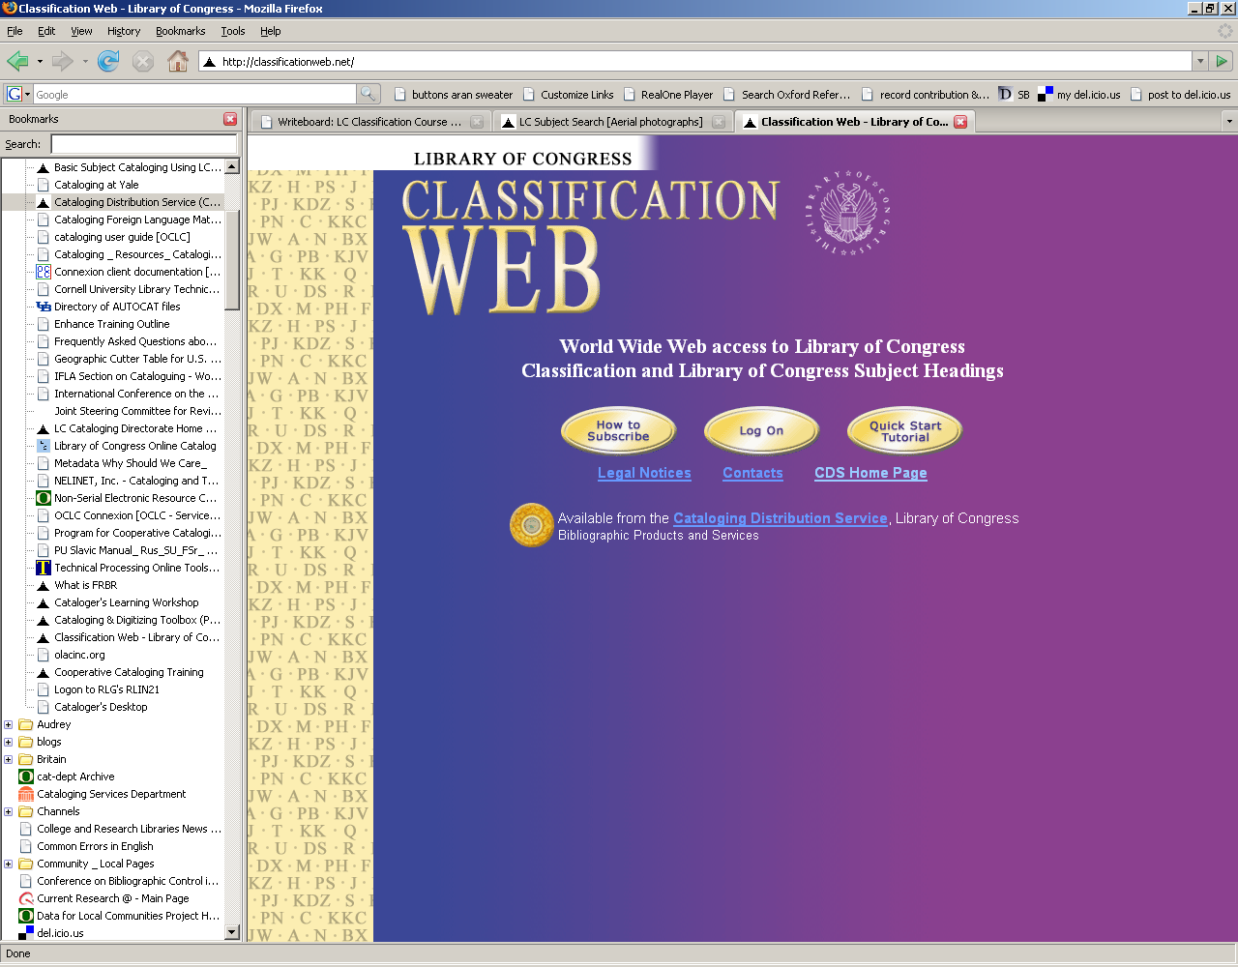
Classification Web
Full-text display of all LCC schedules
LCSH, with links to schedules
Correlations between class numbers and LCSH
Automatic calculation of table numbers
Available by subscription
“Quick Start Tutorial” for help with searching and other features
Notes:
4th bullet: Available by subscription; price based on number of concurrent users.
5th bullet: At the end of this session, we take a brief look at the Tutorial and some of the ClassWeb features (not in-depth training!!)
[NOTE: if you are training a group of attendees who do not have access to ClassWeb at their home institutions, you can omit the slides at the end of this session. It’s still useful to give this brief overview of ClassWeb here.]

Slide 77
Library of Congress Subject Headings
Entries in LCSH sometimes include suggested LC Classification numbers for the heading
  Class numbers represent the most common aspects of the topic
  Added only if very close correspondence between subject heading & LCC schedules
  Class numbers are not always kept up-to-date
  Use as a starting point only! Always consult the LCC schedules
Notes:
4th & 5th sub-bullets: emphasize that class numbers in LCSH entries are created at the time the heading is established. No effort is made to maintain the currency of the numbers as the classification develops.

Slide 78
Authority records
Subject authority records
  contain the same information as LCSH entries
Name authority records
  Literary authors have specific LC Class numbers
    Many appear in name authority records
LC Class number appears in 053 field
Caution: as noted for class numbers in LCSH, not kept up-to-date. Use as a starting point only!
Notes:
[NOTE: 053s are also being added to name authority records for composers now. These are for biography and criticism only, not for works by the composer.
Example, on authority record for Franz Liszt:
053 #0 $a ML410.L7 $c Biography ]

Slide 79
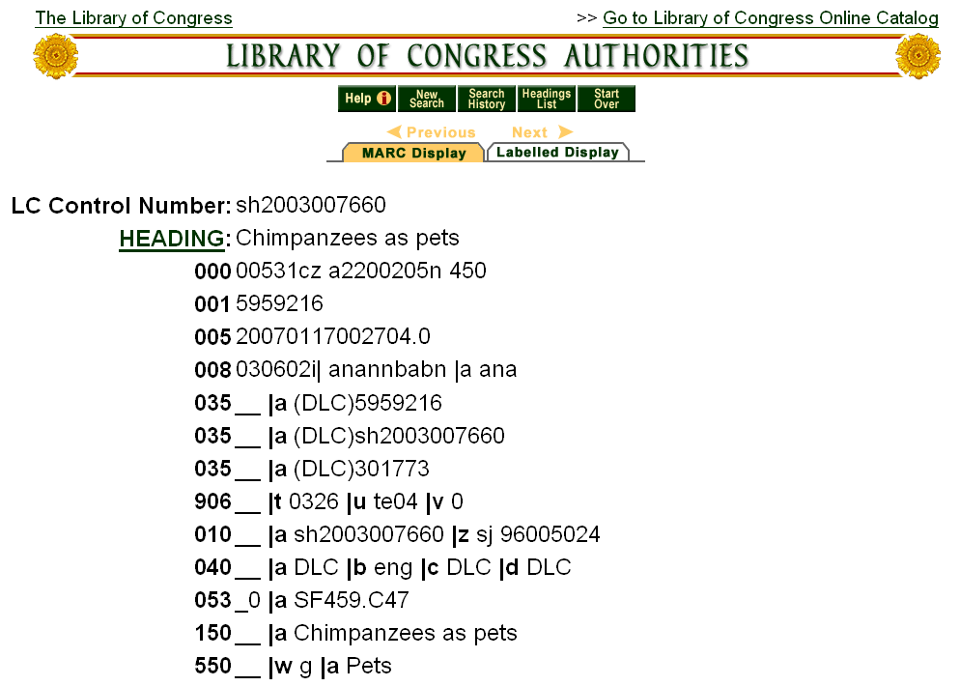
LC Authorities: http://authorities.loc.gov
Notes:
LC Authorities is another resource that can be useful for classification. It includes subject, name, title, and name/title authority records (including in-process subject proposal records). Users can browse and display authority headings and download authority records in MARC format, free of charge.
Here we see the authority record for Chimpanzees as pets, including the class number (SF459.C47) that we saw on the Weekly List (slide 28).

Slide 80
ClassWeb Quick Start Tutorial
Available in ClassWeb and at http://www.loc.gov/cds/classweb/
Help with:
  Browsing class numbers
  Searching (captions, keywords, index terms, etc.)
  Customizing
  Correlating subject headings and class numbers
  And more….
Notes:
[NOTE: if you are training a group of attendees who do not have access to ClassWeb at their home institutions, you can omit most of these slides. However, you should still go over the information in slide 40 that explains the ClassWeb features [H R B L S]. Examples of ClassWeb displays are used throughout the workshop and it’s useful for people to know what these mean.]

Slide 81
What is a call number?
Call number = class number + book number
Class number
  alphanumeric
  taken or derived from schedules
Book number
  also called Item number or Author number
  distinguishes among items classed under the same number
  usually begins with Cutter number
Notes:
A call number consists of two main parts: a class number and a book number.
The class number reflects the subject matter of the work being cataloged. It is alphanumeric and is taken or derived from the classification schedules.
The book number (or item number, or author number) distinguishes among items classed under the same number and organizes works on a subject, generally in alphabetical order by main entry (author or title).
Since 1982, call numbers for monographs also include the date of publication.

Slide 82
Overview: example 1
Animals in translation : using the mysteries of autism to decode animal behavior / Temple Grandin and Catherine Johnson, 2005.
Class number: QL Zoology
751 Animal behavior
Book number: .G73 Cutter for Grandin
2005 Year of publication
4

Slide 83
Overview: example 2
Essential Brittany / by Lindsay Hunt, 1997.
Class number: DC History of France
611 Regions
.B848 Brittany
Book number: H84 Cutter for Hunt
1997 Year of publication
5
Notes:
Some class numbers contain Cutters that reflect subject matter, a geographic area, or a name.
[NOTE: in case anyone asks – the Cutter number for Brittany (.B848) comes from the classification schedule (range of B841-.B9173 is for the history of Brittany, .B848 is Description and travel) . Some Cutters for places are based on G 300 Regions and Countries Table. The Cutter table is not used to formulate these (an attendee asked why the Cutter for Brittany was not .B75 as it would be if derived from the the Cutter table).]

Slide 84
Cutter numbers
Named for Charles Ammi Cutter
  developed several tables using letters and numbers to achieve an alphabetical arrangement
Capital letter followed by Arabic numerals
Cutter numbers may be based on:
  Personal or corporate names
  Geographic names
  Topics
  Titles
Cutters used as book numbers generally correspond to main entry (name or title)
The first Cutter in a call number is preceded by a decimal
6
Notes:
We refer to Cutter numbers throughout this session so here is an explanation of the term.

Slide 85
Class numbers must contain:
one, two, or three capital letters
  D History
  DG History of Italy
  DJK History of Eastern Europe
  K Law
  KF Law of the United States
  KFP Law of Pennsylvania
7
Notes:
Now we’ll take a closer look at the parts of the call number – first the class number.
[NOTE: this was covered in the Outline session, quick review]
A single letter denotes a main class and most subclasses are designated by double letters.
Classes E and F do not use double letters.
Triple-letter combinations have been used only for some subclasses in D and K.
[If more detail is wanted:
D only uses three letters for DAW (History of Central Europe) and DJK (above)
K frequently uses the third letter. In KE (Law of Canada) and KF (Law of the United States) the third letter represents province or state names mnemonically, for example, KFL, Law of Louisiana.]
(Could give example of state or province where workshop is held)

Slide 86
Class numbers must contain: (2)
whole numbers (1-9999)
HV875 Adoption
TK7881 Industrial electronics
  may have decimal extensions
    HV875.5 Intercountry adoption
    TK7881.85 Automobile sound systems and equipment
8
Notes:
A decimal extension is used when it is necessary to insert a topic between two consecutive whole numbers.
HV876 was already used for Children’s villages, so the half-page expansion under Adoption required numerous decimals.
TK area for electronics was squeezed into a small space and requires several pages of decimal expansions.
Decimals MAY represent a subtopic of the whole number, as is the case with the two numbers shown here, but this is not always the case.

Slide 87
Class numbers: decimal extensions
Decimals do not necessarily represent subtopics of a whole number:
Water sports
GV836 Houseboats and houseboating
GV836.2 Swimming. Periodicals
Horse racing
SF357 Individual running races, A-Z
SF357.3 Quarter racing. Periodicals
9

Slide 88
Class numbers may contain:
single Cutter number extension
  BQ5075.P73 Prayer wheels in Buddhism
  HN79.M3 Social conditions in Maryland
  HV5824.C42 Drug use by celebrities
double Cutter number extension
HF5382.5.U6 F64 Vocational guidance in Florida
N6530.N72 C646 History of art in Columbia County, New York
10
Notes:
Cutter numbers shown in these examples have topical significance; they extend the class number.
Cutters numbers may represent topics (prayer wheels, celebrities) or places (Maryland, United States, Florida, New York, Columbia County)
LCC is usually arranged in a logical or hierarchical order, but in many cases, an alphabetical order is used instead. This is common for names of countries, regions, states, cities, etc., for individual biography, and in other cases where a series of topics does not lend itself to a logical or hierarchical order.
Notice that the first Cutter is preceded by a decimal.

Slide 89
Book numbers
Used to arrange material in a given class
  generally by main entry (primary access point)
Usually begin with a Cutter number
  single capital letter, followed by Arabic numerals
  G73 for Grandin H84 for Hunt
  preceded by decimal, if this is the first Cutter
Arabic numerals represent remainder of name or title, derived from Cutter table
Table is in SCM: Shelflisting G 63
Notes:
ANIMATION: click to bring in each bullet
Once you have assigned a class number, you need to determine a book number for the work you’re cataloging, to place it in the appropriate order among other items with that class number. Generally that order is by main entry (or primary access point, in the terminology that is proposed for RDA), though the schedules specify otherwise in some cases.
[NOTE: Alert attendees that they should get the Cutter table out of the appendix at this time.]

Slide 90
Cutter Table examples
After initial vowels
for the second letter: b d l-m n p
use number: 2 3 4 5 6
After initial letter S
for the second letter: a ch e h-i m-p
use number: 2 3 4 5 6
Notes:
Partial view of table, does not show r, s-t, u-y for initial vowels or t, u, w-z for initial letter S

Slide 91
Cutter Table examples (2)
After other initial consonants
for the second letter: a e i o r u
use number: 3 4 5 6 7 8
For expansion
for the letter: a-d e-h i-l m-o p-s t-v
use number: 3 4 5 6 7 9
Notes:
Partial view, does not show letters y for other initial consonants or w-z for expansion
These slides also do not show the portion of the table for initial letters Qu and Qa-Qt
“For expansion” : adding another digit
Can show how the Cutter for Grandin was determined using the table -- G73
Also show what you would find in the table for Hunt -- H86 – and note that it is different from the Cutter assigned in the example given (Essential Brittany, by Lindsay Hunt, Cutter for Hunt is H84). Note that the table is a guide only – it may be helpful in determining the book numbers, but it is just one piece of the process.

Slide 92
Shelflisting
The process of determining the book number is called shelflisting
Shelflist:
  a file of cards or bibliographic records arranged in the same order as the corresponding materials on the shelves
Shelflisting:
  to arrange materials within a subject, normally by author; to determine the book number
14
Notes:
Shelflist can be physical or virtual (call number browse in online catalog); both represent the order of materials on the shelf.
The goal is to arrange materials systematically within a subject. A book number calculated from the Cutter tables often needs to be adjusted based on the works already in the shelflist to achieve this arrangement and to avoid duplicating call numbers.
We’ll go over the basic process of shelflisting in this session; more detail on special situations or types of material follows in later sessions.

Slide 93
Using the Cutter Table: first letter is a consonant
Main entry: Campbell, Joseph
  begin with C
  for 2nd letter a, use number 3: C3
  expansion row : 3rd letter m-o, use 6: C36
Main entry: French political parties…
  begin with F
  for 2nd letter r, use number 7: F7
  expansion row: 3rd letter e-h, use 4: F74
15
Notes:
First, just practice using the table to come up with a Cutter number
Have attendees follow along looking at the Cutter tables
ANIMATION: click to bring in each bullet

Slide 94
Using the Cutter Table: initial vowel, initial letter “S”
Main entry: The “other” eighteenth century
  begin with O
  for 2nd letter s-t, use number 8: O8
  expansion row: 3rd letter e-h, use 4: O84
Main entry: Schreiber, Daniel
  begin with S
  for 2nd letters ch, use number 3: S3
  expansion row: next letter p-s, use 7: S37
16
Notes:
ANIMATION: click to bring in each bullet

Slide 95
Determining the Cutter
Find the filing position in the shelflist
  search by class number and view main entries
  in most cases, arrangement is alphabetical order by main entry
Consider whether use of the Cutter table will achieve the proper position
  if so, use the Cutter table
  if not, adjust by using different numbers or by expanding with additional numbers
The shelflist always takes precedence
Notes:
In the examples just given, we built the Cutter number entirely using the numbers given in the table. However, the goal is to fit your item into the arrangement already in the shelflist.
First, find the filing position in the shelflist.
In many cases, Cutters must be adjusted to file correctly and to allow room for later entries.
Numbers can be expanded decimally – there is no limit.

Slide 96
Where should a new entry file?
G 100 Filing Rules has complete information
General principle: File elements exactly as they appear, word by word, then character by character
File abbreviations exactly as written
Treat hyphenated words as separate words
Ignore initial articles (such as a, an, the)
  list of articles in many languages is in G 100
BUT do not ignore initial articles in personal and place names
Notes:
ANIMATION: click to bring in each bullet
G 100 has many examples of correct practice as well.
This is a much simplified summary of some filing rules.

Slide 97
Adjusting the Cutter: expanding numbers
In order to permit infinite expansion between numbers, Cutters are treated as decimals
.B3
.B47
.B56
.B564
.B583
.B66
.B7
Do not end a Cutter with 1 or 0
Notes:
Given that you may need to “adjust” the Cutter to fit your item into its place in the filing order – how do you do that?
Cutter numbers are treated as decimals, so .B66 files after .B583, .B7 files after .B66, etc.
This makes it possible to insert new numbers into the existing arrangement at any point by adding additional digits to a number and maintain the order.
ANIMATION: click to bring in text box
A zero is not used at the end of a Cutter because it adds no filing value and takes up space.
1 is avoided because to file something before it requires a zero, which can look like a capital O.
Generally speaking, when shelflisting, try to avoid blocking a future work.
[NOTE: spoiler alert: the next three slides pose questions we’ll work through together – the answers are already printed in the manual, so people may want to just watch the screen if they want to try and figure out the answer]

Slide 98
Adjusting the Cutter: expanding numbers
What Cutter would fit between these two?
.S39
.S4
.S392
.S395
.S396
.S3965
.S39995
Notes:
ANIMATION: click to bring in each set of numbers – in the order listed in notes:
Good choices for filing between the two numbers:
.S395
.S396
.S3965
Extremes that might occasionally be required:
.S3922
.S39995

Slide 99
Main entry: letter not given in table
For: Gladwell, Malcolm Cutter table: “L” not specified
Shelflist shows:
BF448 Galotti, Kathleen Making decisions that
.G35 2002 matter
BF448 Gelatt, H. B. Creative decision making
.G45 2003
BF448 Glaser, Rollin O. Groupthink index
.G57 1993
Could use: .G53
Notes:
Many letters are not included in the Cutter table. For example, when Cuttering for the name “Gladwell”, we find that the second letter “L” is not included in the table for letters after initial consonants.
In such cases, you will likely assign the next higher or lower number, adjusting as necessary to fit within the numbers already assigned in the shelflist.
When we look at the shelflist in this case, we see that Gladwell needs to come after Gelatt and before Glaser
ANIMATION: click to bring in arrow
click again to bring in text box
[NOTE: Work shelflisted is Gladwell, Malcom. Blink : the power of thinking without thinking. BF448 = Psychology -- Consciousness. Cognition -- Thought and thinking -- Decision making]

Slide 100
Example: inserting the number
For: Levitt, Stephen Cutter table suggests: L48
Shelflist shows:
HB74.P8 Levine, David P. Normative political
L477 2001 economy.
HB74.P8 Levine, David P. Subjectivity in political
L478 1998 economy.
HB74.P8 Lewis, Alan. New economic mind
L48 1995
Could use: L479
Notes:
ANIMATION: click to bring in arrow
click again to bring in text box
[NOTE: work shelflisted is Levitt, Stephen D. Freakonomics: a rogue economist explores the hidden side of everything. HB74.P8 = Economic theory -- Economics as a science -- Relation to psychology]

Slide 101
Cuttering for numerals: SCM G 63
When Cuttering for Roman or Arabic numerals, use the Cutters .A12-.A19
  PR8858 .A17 1995
  The 1916 poets / edited with an introduction by Desmond Ryan, 1995.
When numerals are expressed as words, Cutter like any other word:
  BM723 .F48 1996
  Fifty-eighth century : a Jewish renewal sourcebook / edited by Shohama Harris Wiener, 1996.
Notes:
1st bullet: Choose a number toward the center of the available span when Cuttering for the first numeral in a class. The middle of the range is used for the first numeral Cuttered because no matter what number you have, there is an infinite number of possible larger and smaller numbers. LC staff are instructed to use .A15 automatically for the first entry beginning with a date.
Reserved Cutters .A12-.A19 use a numerical sort, not an ASCII sort.
Note: If entries already in the shelflist have been assigned “document numbers” (.A5 for the corporate heading United States. Dept. of… ) Cutter numerals to file directly after those entries. Examples:
UF523
.A5 U.S. Ordnance Dept.
1918a Handbook of ordnance data … 1918.
UF523
.A53 1880’s American arms … 1981.
1981

Slide 102
More on class numbers…MAY contain:
a date as an extension of the class number:
JK1968 2004 .R63 2005
Election returns. By date of election
HV600 1746 .L55 P47 2001
Disaster relief. Earthquakes. By date of occurrence
Notes:
Now that you’ve had some practice applying the Cutter table, let’s talk more about what can go into a call number.
Class number is shown in blue.
The next slides demonstrate guidance in how to subarrange such numbers.

Slide 103
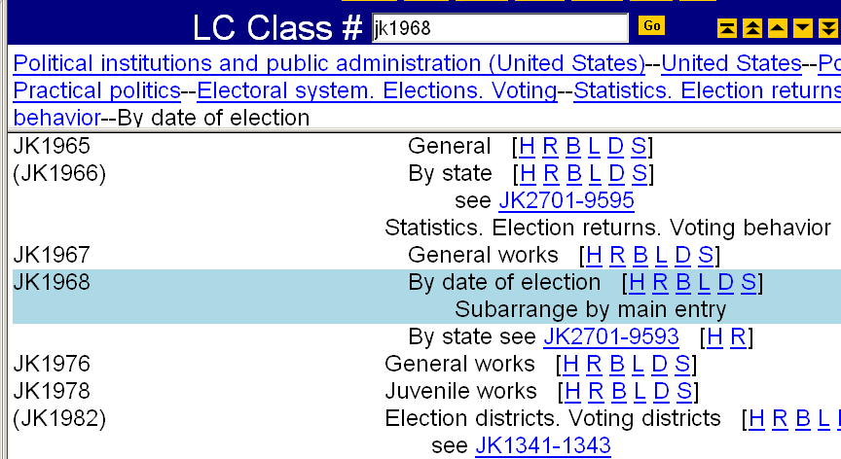
Example from Classification Web
Notes:
The schedules provide instructions in such cases, including instructions on how to subarrange items within the class number.

Slide 104
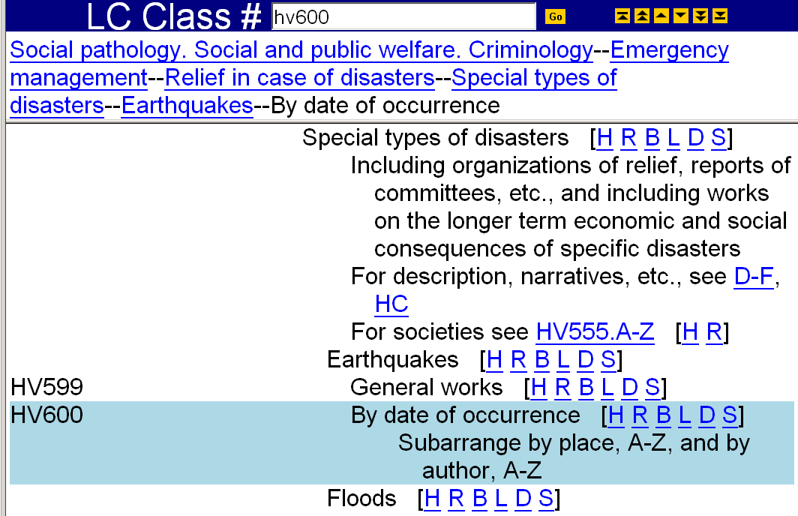
Example from Classification Web

Slide 105
Example of complete call number
For a work about the 1746 earthquake in Lima, Peru with main entry Pérez:
HV Social pathology. Social and public welfare
600 Earthquake relief
1746 Date of occurrence
.L55 Subarranged by place Lima
P47 Cutter for Pérez
2001 Date of publication

Slide 106
How many Cutter numbers?
Schedules may provide instructions for sub-arrangement
  these always take precedence over general practices
No more than two Cutter numbers in a call number (except G schedule)
If there are no special instructions in the schedules assign single Cutter for main entry
  QL751.G73 Grandin, Temple
Notes:
2nd bullet: Call numbers for maps in class G may in some cases contain three Cutters – very specialized practices in G, not covered in this basic workshop
FYI: a Cutter for a geographic area (local areas), a subject letter number representing the subject focus of the map (such as .P2 for a road map), and a Cutter for main entry.

Slide 107
How many Cutter numbers?
If class number includes a Cutter (representing topic, place, etc.):
  assign an additional Cutter for the main entry:
  DC611.B848 H84 Hunt, Lindsey
  HN79.M3 C37 Carr, Lois
  HV5824.C42 K87 Kusinitz, Marc
Notes:
Again, this assumes there are no special instructions in the schedules
Examples:
DC611.B848 - History of France, Brittany
HN79.M3 - Social conditions in Maryland
HV5824.C42 – Drug use by celebrities

Slide 108
How many Cutter numbers?
If class number requires two Cutter numbers to express the topic:
  add digits to the second number to achieve alphabetical arrangement by main entry
  HF5382.5.U6 F6+ Florida
  F62 one work about Florida
  F64 another work about Florida
  F645 yet another…
  F67 and another
Notes:
Topic here is vocational guidance in Florida.
Many shelflisters use the “expansion” part of the Cutter table for selecting a digit expansion of the second Cutter.
FYI: examples are from the LC shelflist:
F62 Florida Industrial Commission. Florida job guide for young workers … 1959.
F64 Florida State Employment Service. Florida job guide for young workers … 1957.
F645 Florida VIEW. Careers. 1994.
F67 Smith, Tom Q. 47 ways to make money in Florida. 1952.

Slide 109
A-Z Topical Cutters
Topical Cutters are used in a schedule when a series of topics does not lend itself to a logical or hierarchical order:
TX557 Vegetables, cereals, fruits, etc.
558 Special, A-Z
.A3 Acorns
.A6 Apples
.B3 Bananas
.B35 Barley
Notes:
We’ve seen some examples of topical Cutters already; here is more information about them.
There is more on formation of topical Cutters in the sections on individual schedules such as H.
[NOTE: TX557 -- Dietary studies, food values, experiments, tests, etc. for vegetables, cereals, fruits, etc.]

Slide 110
A-Z Topical Cutters (2)
Most topical Cutters are printed in the schedules
  Previous practice: in some areas, only representative or sample Cutter numbers were given, preceded by “e.g.”
  Some types of Cutters are not printed: personal, corporate, geographic names, languages (when topic is subarranged by language)
Notes:
If the question comes up: can I use a topical Cutter that is not in the schedules without proposing it?
Here are some considerations:
Cutters should be established in the schedule if not preceded by “e.g.”
Some libraries create their own topical Cutters based on what makes sense in their own catalog.
Disadvantages to creating your own topical Cutter without proposing it include:
LC may later establish a topical Cutter for that topic that is different from the one you used
Most catalogers using your record as copy would assume the Cutter has been established, unless you code your call number as a non-LC call number
Different libraries could use different terminology for the topic, so different Cutters could be used for the same concept
Keeping track of Cutters assigned locally can be challenging

Slide 111
Reserved Cutter numbers
A span of Cutter numbers at the beginning (“A”) or end (“Z”) of the sequence set aside for special purposes
“A” Cutters are often for form divisions (periodicals, congresses)
“Z” Cutters are often for special divisions of the subject (biography and criticism of a literary author)

Slide 112
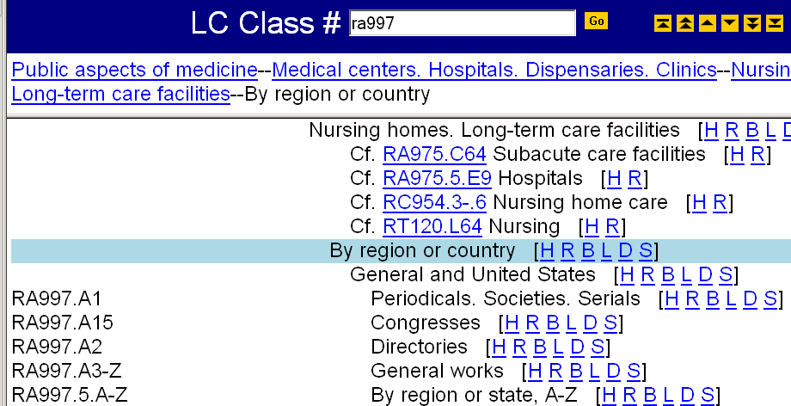
.A1, .A15, .A2 are reserved
For general works, Cutter for main entry “Abell” should be greater than .A3
For reserved Cutters, add a second Cutter based on main entry
Notes:
Cutter numbers .A1, .A15, and .A2 have been assigned special meanings here.
What if you had a general work:
ANIMATION: click to bring in arrow
and you needed to assign a Cutter for an author named Abell? According to the Cutter table this would be .A23, but you would need to assign a Cutter greater than A3 because .A2 has a specific meaning.
ANIMATION: click again to bring in text box “For general works…”
Also, notice that you cannot follow the general practice for Cuttering for numerals (using A12-19) in this situation. Entries beginning with numerals need to appear before entries beginning with the letter A, so space should be left for numerals.
ANIMATION: click to bring in “For reserved Cutters…” text box
When you assign one of the reserved Cutters (for a periodical or a congress or a directory, for example), you add a second Cutter based on main entry.

Slide 113
Additions to call numbers
Date of publication is added in most cases
Work letter (or mark)
Volume number
Terms such as Index or Suppl.
Local decisions:
  Copy 1, 2, etc.
  Oversize designation
Notes:
We’ve talked about class numbers and book numbers, and how Cutter numbers are used in each.
These are some additional elements you may see in call numbers.
Date of publication is added in most cases, but the others will be added only in certain situations. We’ll see examples of these throughout the workshop, but will address the general practice for adding dates now.

Slide 114
Date of publication: G 140
General rule: add the date of imprint to all monographs
  prior to 1982, not done routinely
Dates are not added to the call numbers for serials and certain loose-leaf publications associated with legal materials
G 140 includes instructions on handling multiple or complex dates
  and exceptions to the general rule
Notes:
LC practice: an imprint date is routinely added to book numbers for monographs (policy established in 1982)
Note that the practice of adding dates to the call numbers of monographic works applies to cataloging performed since 1982, not items published since 1982. A title cataloged today for a 1975 imprint would include a date in the call number.

Slide 115
MARC 21 Coding
In a bibliographic record, the LC call number appears in field 050
050 00 $a QL751 $b .G73 2005
050 00 $a RC569.5.S56 $b B36 1988
Subfield codes:
  $a Classification number
  $b Item number
Notes:
Subfield $a contains the classification number portion of the call number. Subfield $a may be repeated to record an alternative class number.
Subfield $b contains the item number portion of the call numbers (“item number” here is MARC 21 terminology)
FYI: other subfields are defined in the MARC 21 format but are not commonly used in general cataloging so not covered here ($3, $6, $8)

Slide 116
050 field: indicators
First indicator: existence in LC collection
_ No information provided
0 Item is in LC
1 Item is not in LC
Second indicator: source of call number
0 Assigned by LC
4 Assigned by agency other than LC
Notes:
Both of the examples in the previous slide had indicators “00” – held by LC, assigned by LC.

Slide 117
MARC 21 Coding
Reminder: classification number portion of the call number may include a Cutter
050 00 $a QL751 $b .G73 2005
050 00 $a DC611.B848 $b H84 1997
First Cutter is preceded by decimal
General rule: delimiter for the item number ($b) precedes the last capital letter
Notes:
2st bullet:
ANIMATION: click to bring in arrows
In addition, sometimes the Cutter in the item number portion is actually part of the class number, when two Cutters are needed to express a topic.
$b delimiter also precedes the decimal before that letter, if present

Slide 118
http://openlib.org/home/krichel
  Thank you for your attention!
  Please switch off machines b4 leaving!

