Slide 1
LIS618 lecture 2 the Boolean model
Thomas Krichel
2011-04-21

Slide 2
reading
We follow Manning, Raghavan and Schuetze here, chapter one.
I leave out stuff that relates to running things on a computer in an efficient way.
I add some more basic mathematical theory that we need.

Slide 3
the Boolean model
The Boolean retrieval model is being able to ask a query that is a Boolean expression.
Primary commercial retrieval tool for 3 decades.
Many search systems you still use are Boolean.
It is a preferred tool for expert searchers.
It leaves non-experts baffled.

Slide 4
what is Boolean?
A Boolean variable is a variable that takes only two values. You can label that as you like
‘true’ ‘false’
‘black’ ‘white’
‘1’ ‘0’
I will use 0 and 1 here.

Slide 5
Boolean operator: not
It is written as ¬, but here we use NOT
Rules
NOT 0 =1
NOT 1 = 0

Slide 6
Boolean operator: and
It is written as AND in the slides.
Rules
0 OR 0 = 0
0 OR 1 = 0
1 OR 0 = 0
1 OR 1 = 1

Slide 7
Boolean operation: or
It is written as OR here.
Rules
0 OR 0 = 0
0 OR 1 = 1
1 OR 0 = 1
1 OR 1 = 1

Slide 8
operator precedence
NOT operations are conducted first.
Then AND operations are conducted.
Then OR operations are conducted.
Thus, for example
NOT A OR B AND C = (NOT A) OR (B AND C)
If you want to express another precedence, you need parentheses.

Slide 9
exercises
(NOT (0 OR NOT1)) OR (1 AND NOT (0 OR 1))
NOT 0 AND 1 OR 0 AND 1 OR 1 AND NOT 1
0 AND 1 OR 1 AND NOT 0 AND NOT 1 OR 0

Slide 10
example
Consider Shakespeare’ collected plays.
It contains just under one million words.
Task is to find which plays contain the words Brutus and the word Caesar, but not the word Calpurnia.
Simplest solution: have a computer read all the plays, examine each play at a time.
It’s a non-starter when the collection is large.

Slide 11
grepping
There is a unix utility called grep that allows you to find an expression in a file.
That expression may not just be a literal. It make contain “wildcard” such as a *.
But the principle of grepping is that we look at the file line by line and find where we find a machining line.

Slide 12
term-document incidence matrix
We can build an index of all words that Shakespeare used, and note in what plays they come up.
Shakespeare used about 32000 different words, so it’s not all that big.
For each term, we have a series of 0s and 1s depending whether they were in a play.

Slide 13
Term-document incidence
1 if play contains word, 0 otherwise
Brutus AND Caesar AND NOT Calpurnia

Slide 14
Incidence vectors
So we have a 0/1 vector for each term.
To answer query: take the vectors for Brutus, Caesar and Calpurnia (complemented) ➔ bitwise AND.
110100 AND 110111 AND 101111 = 100100.
14

Slide 15
Answers to query
Antony and Cleopatra, Act III, Scene ii
Agrippa [Aside to DOMITIUS ENOBARBUS]: Why, Enobarbus,
When Antony found Julius Caesar dead,
He cried almost to roaring; and he wept
When at Philippi he found Brutus slain.
Hamlet, Act III, Scene ii
Lord Polonius: I did enact Julius Caesar I was killed i' the
Capitol; Brutus killed me.
15

Slide 16
some requirements
We need to look at large documents. The amount of digital data grows at least as the speed of computers.
It would be difficult to do more complicated operations such as allowing for proximity.
Allowing for ranking of retrieval result.

Slide 17
indexing
The term/document incidence matrix only works for a small number of documents containing a small number of terms.
We need a different tool and that is some form of index.
An index can take many forms, in fact.

Slide 18
document handle
We assume that we have a bunch of documents of interest.
Each document has some identifier.
This is called the docID in the following.
Example
file name on disk
URL on web (URLs can point to parts of a page)

Slide 19
document part of interest
There may only be one part of the document that you would think that a user would want to retrieve.
But that part depends critically on the type of documents you use.
Examples…

Slide 20
document types
A collection of poems.
A set of email files.
The books of the bible.
The plays of Shakespeare
A set of PowerPoint slides.

Slide 21
prep work
We split the text into a series of tokens that we allow to search for.
We normalize the tokens in some fashion by linguistic processing.
Let us think of the normalized tokens as words.

Slide 22





Inverted index construction
Sec. 1.2
Documents to
be indexed
Friends, Romans, countrymen.
Tokenizer
Token stream
Friends
Romans
Countrymen
Linguistic modules
friend
roman
countryman
Modified tokens
Indexer
friend
2
4
roman
1
2
Inverted index
countryman
13
16

Slide 23
Inverted index
Sec. 1.2
For each term t, we must store a list of all document handles that contain t.
Brutus
1
2
4
11
31
45
173
174
Caesar
1
2
4
5
6
16
57
132
Calpurnia
2
31
54
101
23

Slide 24
Indexer steps: Token sequence
Sec. 1.2
Sequence of (Modified token, Document ID) pairs.
Doc 1
Doc 2
I did enact Julius
Caesar I was killed
i' the Capitol;
Brutus killed me.
So let it be with
Caesar. The noble
Brutus hath told you
Caesar was ambitious

Slide 25
Indexer steps: Sort
Sec. 1.2
Sort by terms
And then docID
Core indexing step

Slide 26
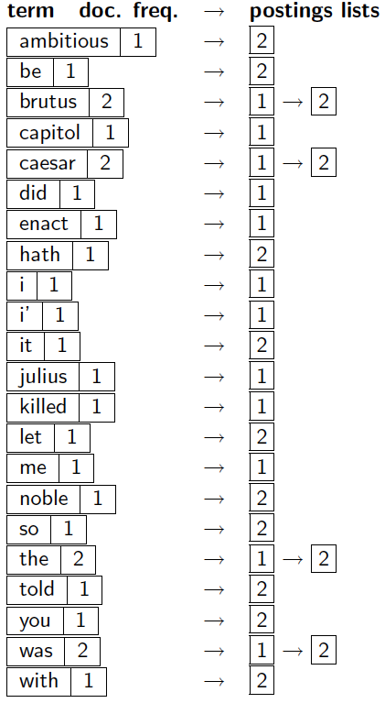
Indexer steps: Dictionary & Postings
Sec. 1.2
Multiple term entries in a single document are merged.
Split into Dictionary and Postings

Slide 27
Where do we pay in storage?
Sec. 1.2
Lists of docIDs
Terms and counts
Pointers
27

Slide 28
Query processing: AND
Sec. 1.3
Consider processing the query:
Brutus AND Caesar
Locate Brutus in the Dictionary;
Retrieve its postings.
Locate Caesar in the Dictionary;
Retrieve its postings.
“Merge” the two postings:
2
4
8
16
32
64
128
Brutus
1
2
3
5
8
13
21
34
Caesar
28

Slide 29
The merge
Sec. 1.3
Walk through the two postings simultaneously, in time linear in the total number of postings entries
2
2
4
4
8
8
16
16
32
64
128
32
64
128
Brutus
2
8
1
Caesar
1
2
2
3
5
5
8
8
13
13
21
21
34
3
34
29

Slide 30
example we can solve by grepping
Documents
1: “a t t g m n u u l f”
2: “p b a l m n y s a g”
3: “p a l f b m s y u l”
Queries
a AND NOT b OR NOT f
p OR NOT m OR f AND NOT s

Slide 31
the index
a 1:1 3:2 2:3 2:9 b 3:5 2:2
f 1:10 3:4 g 1:4 2:10
l 1:9 3:3 3:10 2:4 m 1:5 3:6 2:5
n 1:6 2:6 p 3:1 2:1
s 3:7 2:8 t 1:2 1:3
u 1:7 1:8 3:9 y 3:8 2:7
We could use this to solve proximity queries.

Slide 32
summary
The Boolean model is unambiguous.
The Boolean model is based on sets.
Every term generates a set.
Sets can be combined with Boolean operators to build highly sophisticated queries … that only search wonks understand.
Normal mortals search: “cats and dogs”.

Slide 33
http://openlib.org/home/krichel
Please shutdown the computers when
you are done.
Thank you for your attention!

