Slide 1
GML’s Artwork Collection – Media RSS Plugin
Amanda Paduano
Building Digital Libraries – Thursday, Brentwood

Slide 2
Media RSS Plugin
Plugin works with Moxilla Firefox Internet Browser
Cooliris for Firefox must be installed
Cooliris is a media browser that allows the user to find, view, and share photos and videos
Cooliris creates a 3D wall to “effortlessly scroll content from Facebook, Google, Youtube, Flickr, and more.

Slide 3
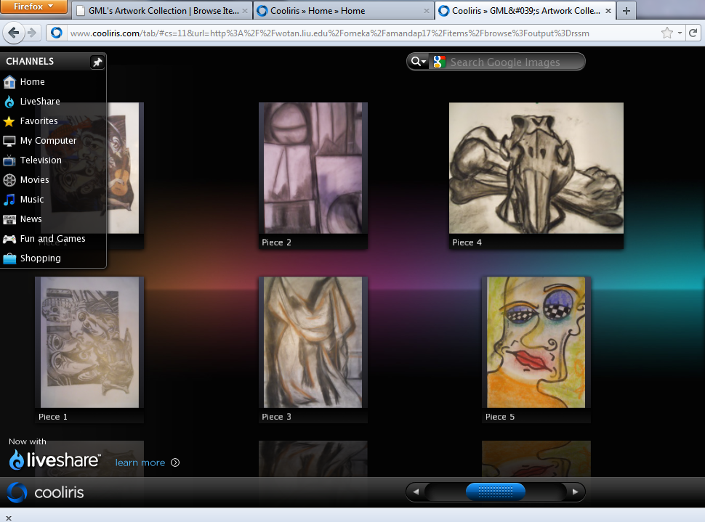

Slide 4
How the plugin works
Cooliris for Firefox needs to be downloaded and installed on the device the user is viewing the Omeka site from.
If the user regularly uses Cooliris to view other forms of media, this plugin is a convenient addition to the Omeka site.
Media RSS plugin works simply with Cooliris.
From the Omeka site, when scrolling over an item, an image of a grid appears over the item. Simply click on this link and a new tab opens in Firefox which allows you to view items through Cooliris.

Slide 5
How to install Media RSS to Omeka
After downloading the plugin, the folder containing the plugin must be added to WINscp.
The folder is added to the plugins folder which is a sub-folder of the omeka folder.
Code needs to be copied and pasted into another folder in this order: Themes, into the folder of the theme of your omeka site, into the common folder, then finally it is pasted above a piece of specified code in the header folder.
After the new code is saved, plugin can be installed from the wotan-omeka site and is then activated.

Slide 6
Plugin works very smoothly for Cooliris and Firefox users.
Plugin is simple – it is a link that the user can choose to use or not. Link does not appear if Omeka site is used with a different web browser such as Internet Explorer or Google Chrome, so it is not an annoying pop-up for users who do not have Cooliris.
However, the latest edition of Cooliris for Firefox has been receiving poor reviews – it differs greatly from the original version and users aren’t happy.
In Conclusion, if you use this media browser, the plugin is a great addition to the site.

