Slide 1
SimplePages for Omeka
Catherine Gorden LIS654 November 3, 2011

Slide 2
SimplePages Definition
SimplePages is a plugin for Omeka that allows content to be added to an Omeka site by creating webpages using a simple form.
The SimplePages form creates a new page within the Omeka template.
The SimplePages form creates a navigation button and slug for the new page.
SimplePages allows the creation of content using plain text, HTML, or PHP.

Slide 3
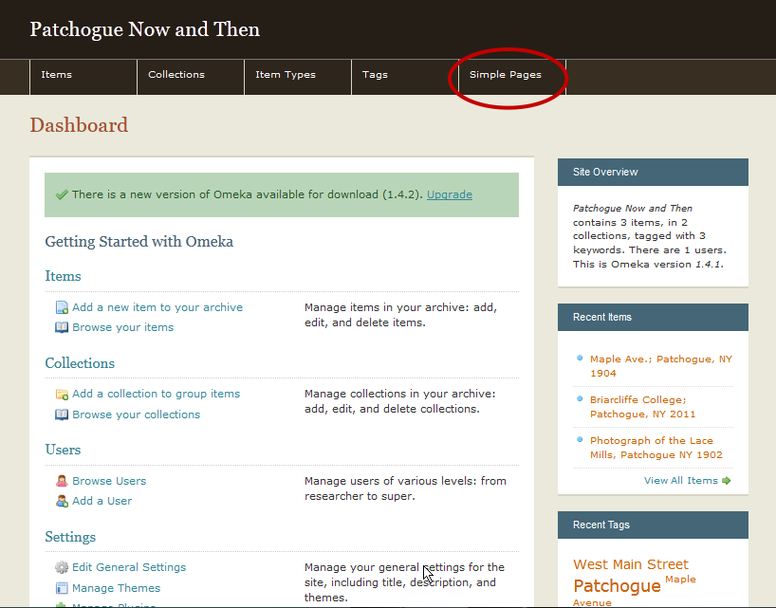
Getting Started
After installing the SimplePages plug-in within Omeka and new tab titled Simple Pages will appear in the Omeka Administrator.
(SimplePages can be downloaded at: http://omeka.org/add-ons/plugins/simple-pages/)

Slide 4
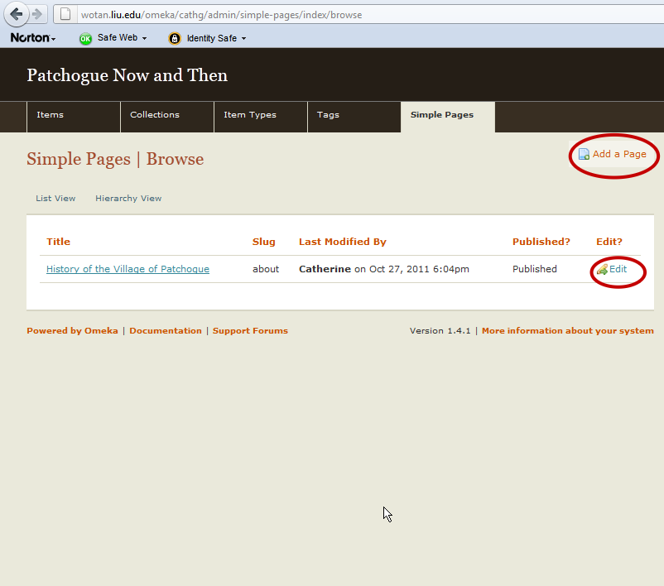
SimplePages
The SimplePages tab opens with two choices:
Create a new page.
Edit a pre-existing demo page.
Both options will lead to the same form for building website content within the Omeka site.

Slide 5
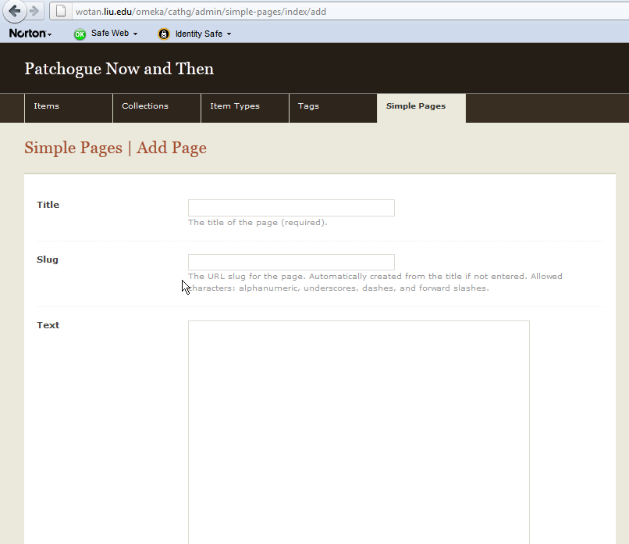
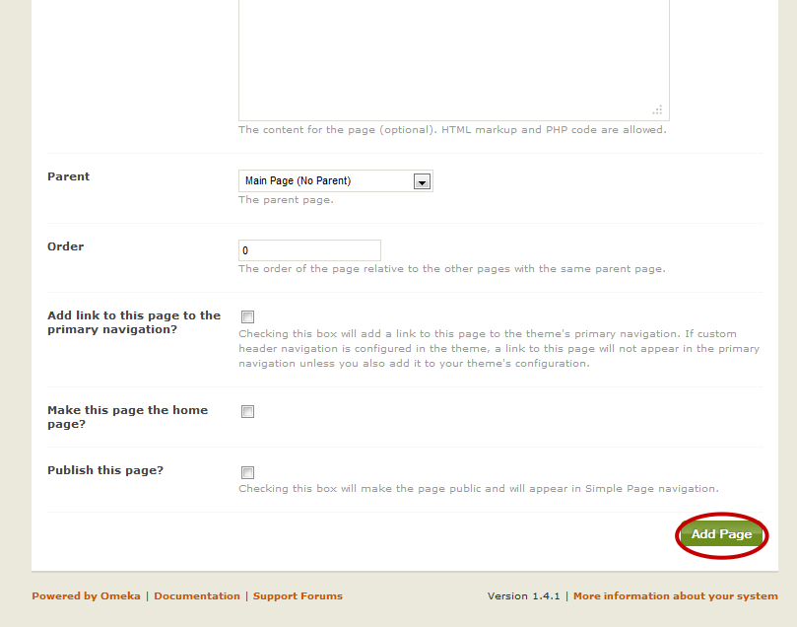
SimplePages Form
The form field options include:
Title
Slug
Text
Parent
Order
Add link to this page to the primary navigation?
Make this page the home page?
Publish this page?

Slide 6
The Title and The Slug Fields
Title:
A plain text field
The page title field is the only required field within the form.
Slug:
A plain text field
The Slug is the name added to the url for this specific page. i.e. if your URL is www.mysite.com/about_us.htm, about_us would be the slug for the new page.
Omeka will automatically create the slug from the Title Field if this field is left blank.

Slide 7
The Text Field
The Text Field is optional, however it contains the content of the webpage.
Information can be added to this field using:
Plain Text
HTML Code
PHP

Slide 8
HTML
According to the w3.org web design standards HTML is the language for describing the structure of web pages.
The Web Design Standards can be found at http://www.w3.org/standards/webdesign/
Tutorials on how write HTML can be found at http://www.w3.org/wiki/HTML/Training

Slide 9
HTML Example
<p> Patchogue, NY is located on the south shore of Long Island approximately 60 miles east of Manhattan. Early settlers were attracted to the location because of the potential to build mills on the local rivers. In 1812 Patchogue consisted of 75 residents and two roads, Main Street (Montauk Highway) and The Lane (Ocean Avenue). Patchogue became an incorporated village in 1893. By 1900 the population had grown to 2,926. At the time of the 2010 US Census the population the Village of Patchogue included 11,798 people. </p>
<p> Link to additional information on the History of Patchogue, NY at: </p>
<ul>
<li> <a href="http://www.patchogue.com/patchoguehistory.htm"> Patchogue History: Queen City of Long Island's South Shore</a></li>
<li><a href="http://www.greaterpatchoguehistoricalsociety.com"> Greater Patchogue Historical Society</a></li>
<li><a href="http://www.pmlib.org/localpmhistory"> Patchogue-Medford Library: Patchogue-Medford Area History</a></li>
<li><a href="http://www.patchoguevillage.org/"> The Incorporated Village of Patchogue</a></li>
<li><a href="http://en.wikipedia.org/wiki/Patchogue,_New_York"> Wikipedia: Patchogue, New York</a></li>
</ul>

Slide 10
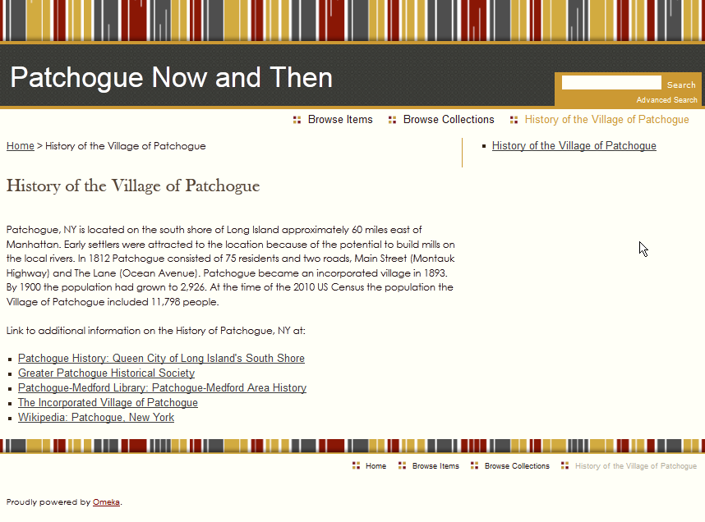
Example as a published web page:

Slide 11
PHP
According to php.net, PHP, which stands for "PHP: Hypertext Preprocessor" is a widely-used Open Source general-purpose scripting language that is especially suited for Web development and can be embedded into HTML. Its syntax draws upon C, Java, and Perl, and is easy to learn.
A Manual for PHP can be found at: http://www.php.net/manual/en/

Slide 12
The Parent Field
Drop down field that gives the choice of making the new page a subpage of the main page (No Parent Option) or subpage of an already existing (parent) page.
This is a nice option for creating a hierarchy of pages or nested pages.

Slide 13
Additional Form Fields
Order
Give each webpage created a numeric value to designate page order.
The order of the page is relative to the other pages with the same parent page.
Add link to this page to the primary navigation?
Checkbox
Select to have a link for the new webpage added to the sites navigation menu

Slide 14
Additional Form Fields
Make this page the home page?
Check box
Designate a customized page as the home page for the Omeka site.
Publish this page?
Check box
Check when the new page is complete and ready to be viewed in the public Omeka site.

Slide 15
Save the Page
At the bottom of the form page there are two buttons:
A green button to save the page
Navigating away from the page without clicking the save button will result in the loss of any information entered into the form.
It is possible to save the page without publishing it to the public site.
A red button to delete the page

Slide 16
More Information
Omeka offers additional information on SimplePages at: http://omeka.org/codex/Plugins/SimplePages
Omeka also offers a support forum for SimplePages at: http://omeka.org/forums/forum/plugin

