Slide 1
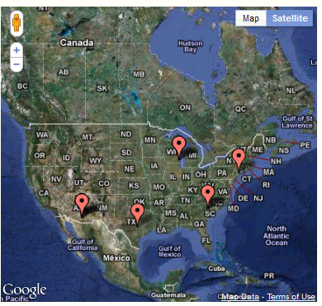
Geolocation Plugin http://wotan.liu.edu/omeka/gina/

Slide 2
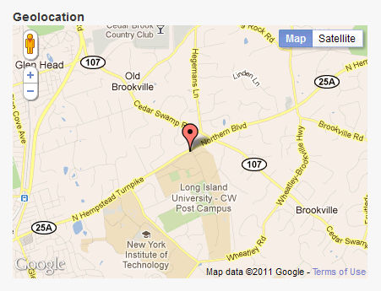
Geolocation Plugin
The geolocation plugin will be used to show the location of each University on a map

Slide 3
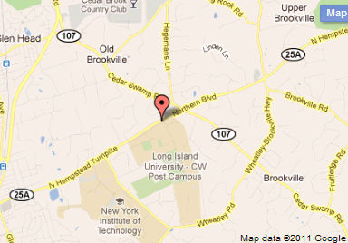
Purpose of Geolocation
Allows admin to save geolocation data for an individual item
Generates a Google map containing items with geolocation data and a web page for displaying the map

Slide 4
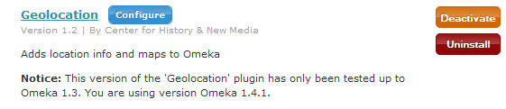

Configuring Geolocation Plugin
From the admin->Settings->Plugins page,
Click the Configure link to add:
Number of locations displayed per page
Default location coordinates for your map (the location that displays at the center of the map)
Default zoom level (enter a number from 1-20, where 1 displays view of Earth and 20 shows exact placement on the street)
Size of the map (if left blank, the default width is 100% and height is 300px)
Link to map in the Items/browse navigation-adds a link to the items page for browsing the map

Slide 5
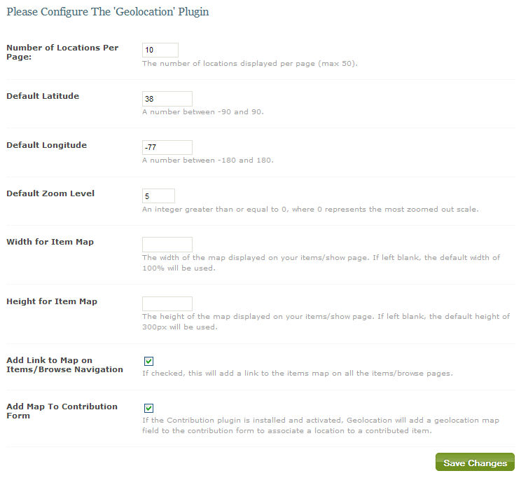
Admin Configure Settings

Slide 6
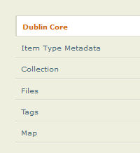
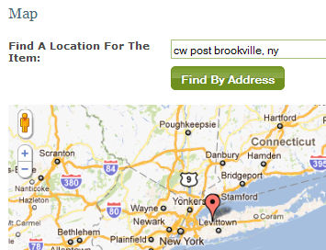
Adding Geolocation Data to Items
When editing an item, click on the Map tab on the left side of the page, then:
Add an address in the “Find a Location for the Item” field and click “Find by Address”
You can also click a location on the map to find a location
Save the changes and the location will be saved and displayed with that item.

Slide 7
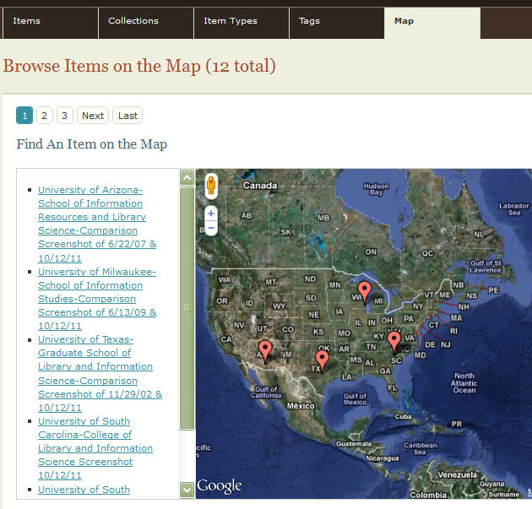
Admin Map
Once installed, the admin and super users can
browse all items that have been located on the map by clicking on the map tab from the main admin dashboard

Slide 8
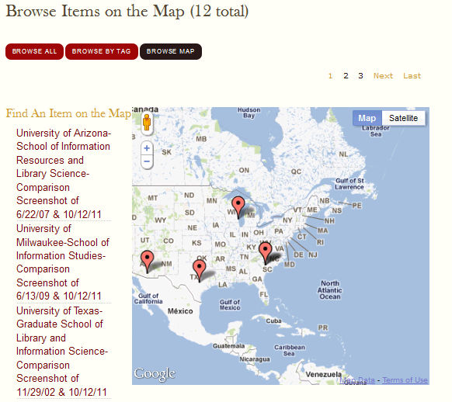
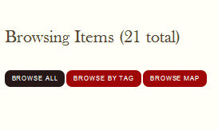
Browsing Items in the Public Map
From the items/browse page, users can click the “Browse Map” link and can browse items via a Google Map

Slide 9
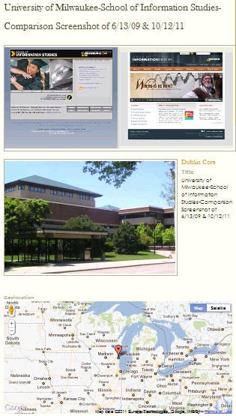
Sample Item with Map

