Slide 1

The Evolution of LIS Academic Websites http://wotan.liu.edu/omeka/gina/
Then & Now

Slide 2
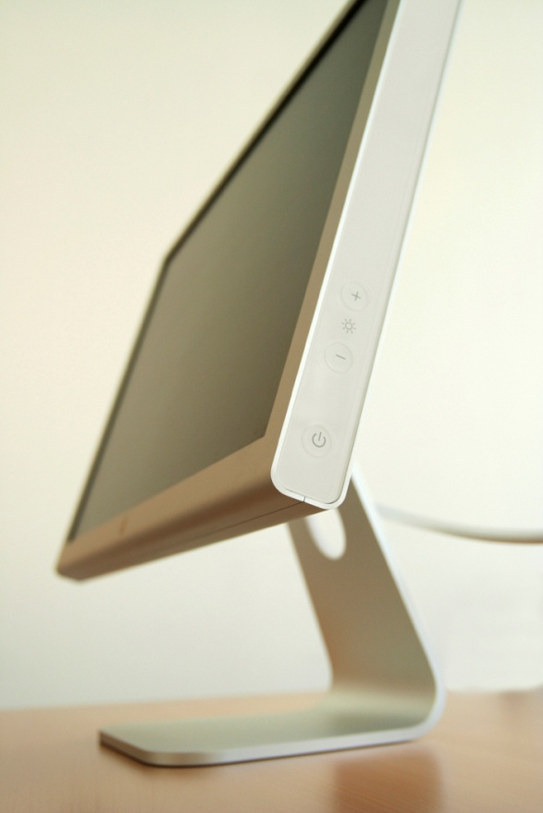
Purpose of Digital Library
To compare several
LIS Academic Websites
over a period of time showing:
Screenshots of each original webpage
Screenshots of each current webpage

Slide 3

Collections in the Digital Library
Items in the Digital Library will be organized by collections according to University
Each collection will contain 3 items:
Screenshot of original webpage
Screenshot of current webpage
Screenshot of both side by side

Slide 4
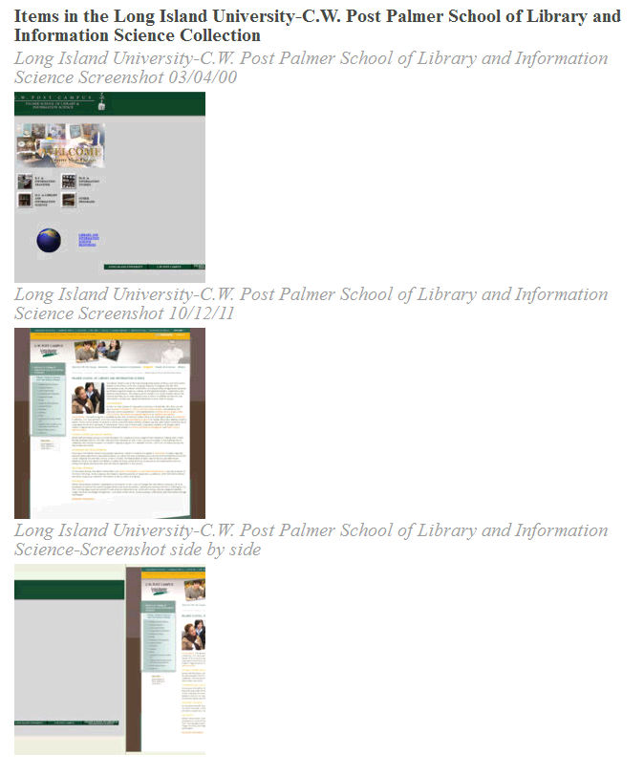
Palmer School Collection

Slide 5
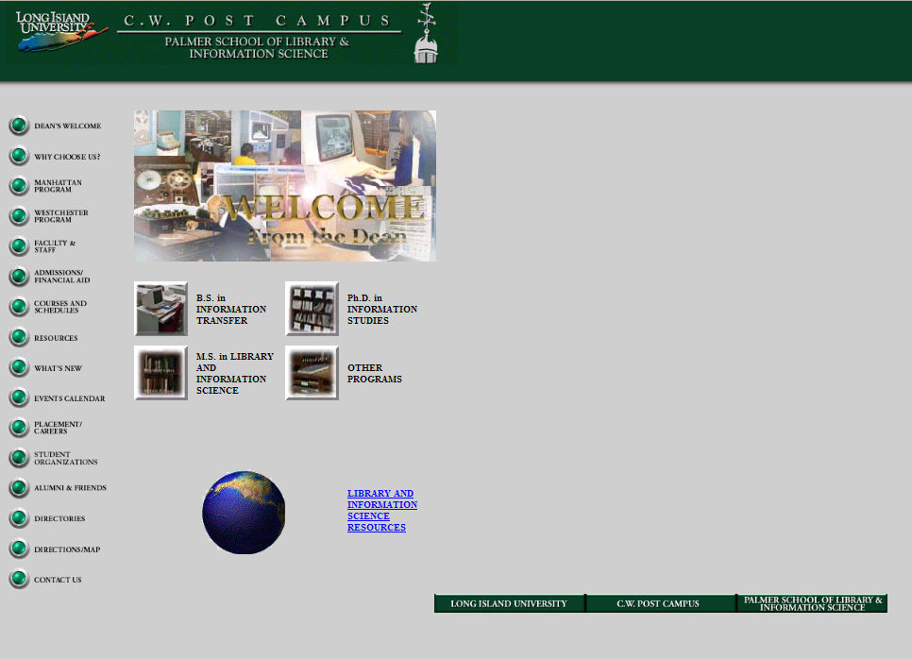
Original webpage

Slide 6
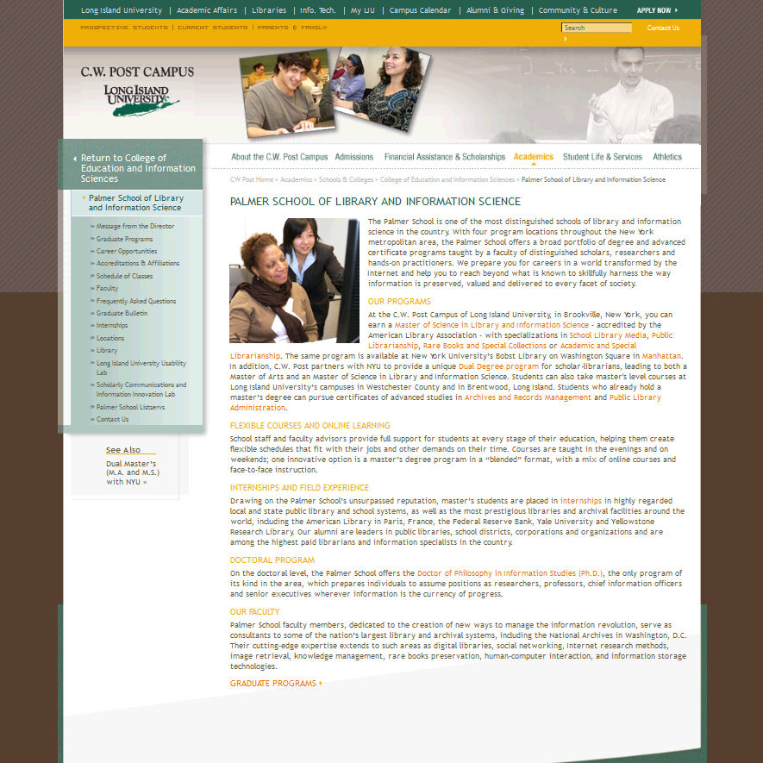
Current webpage

Slide 7
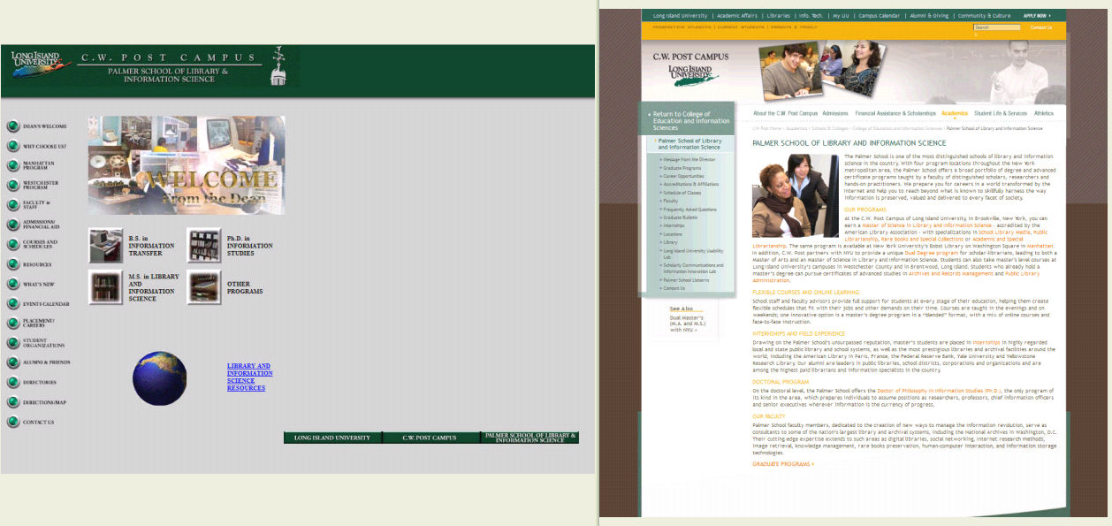
Side by Side Comparison

Slide 8

Items in the Digital Library
Each item will contain Dublin Core metadata along with:
Thumbnails of screenshot images
Geolocation map

Slide 9
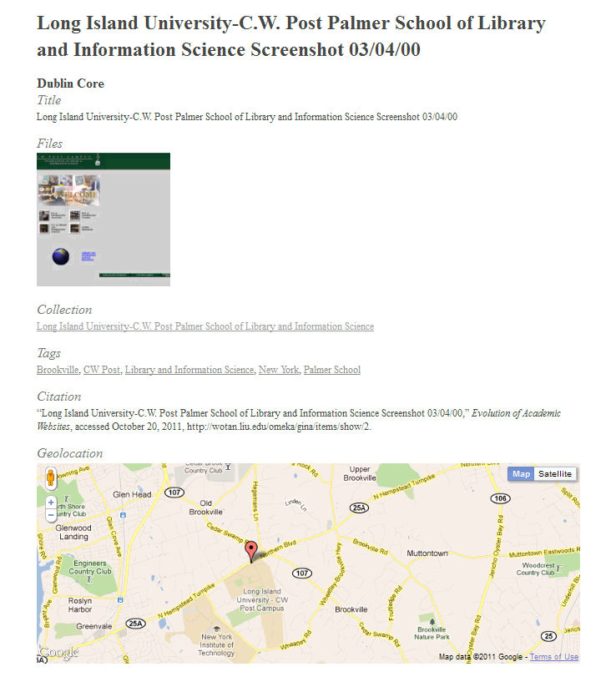
Palmer School Item

Slide 10
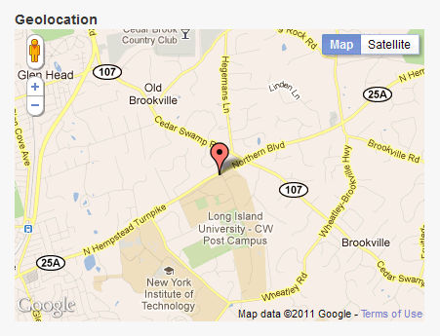
Geolocation Plugin
The geolocation plugin will be used to show the location of each University on a map

Slide 11


Observations
Using web.archive.org
I discovered the following:
most made dramatic changes
one didn’t change at all
many were difficult to show – archive was unable to preserve flash on current sites, so used screen capture software using live site

