Slide 1
Digital Library
Jennifer McHgugh

Slide 2
My digital library will include images of my own art work. All of the images were created while working on my BA in Art History and Theory

Slide 3
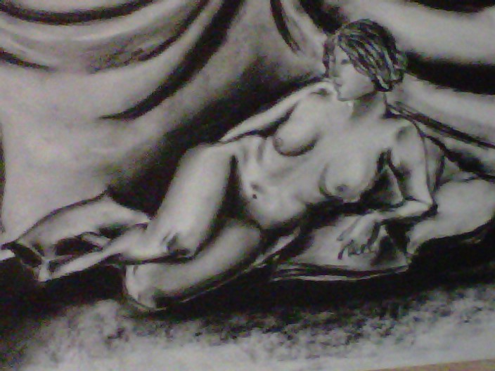
Collections
Drawing

Slide 4
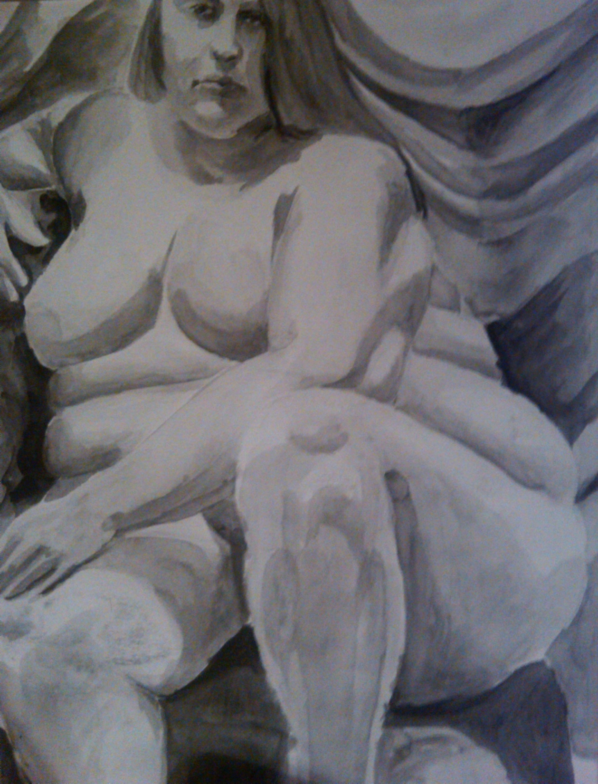
Collections
Painting

Slide 5
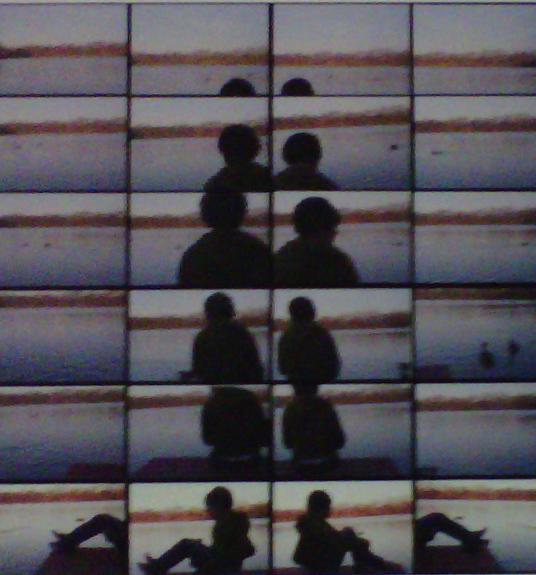
Collections
Photography

Slide 6
All images will be tagged according to the subject of the image, as well as the media used to create it. Ex: charcoal, pencil, film, watercolor, female, nude, etc.

Slide 7
Plug in I plan to use the comments plugin in my digital library. I think it would be helpful and interesting to get feedback on my art.

