Slide 1

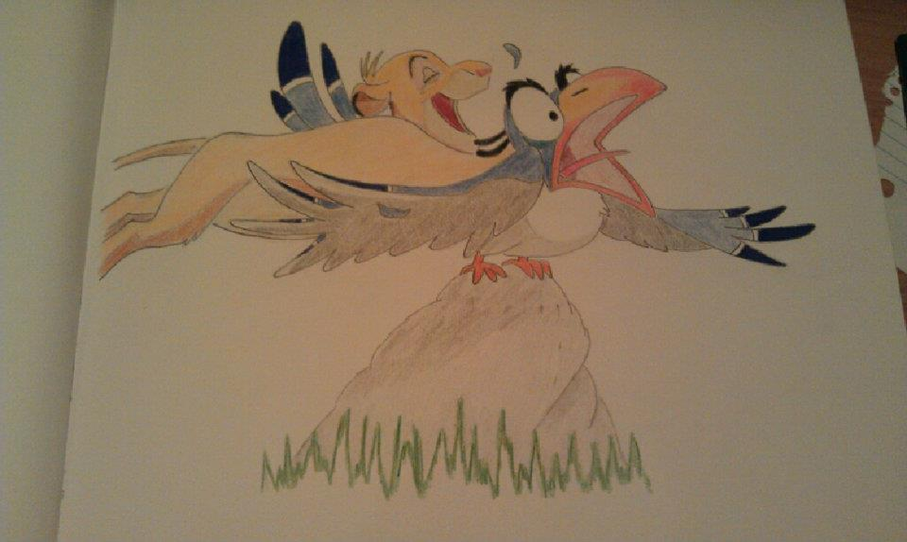
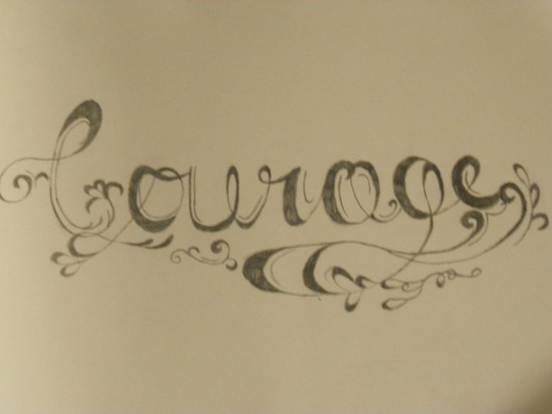
Project Plan:
For my digital library, I will display Rachael Goldstein’s (my sister) pencil drawings.

Slide 2
Library:
I plan to divide the drawings into the following collections:
Original Drawings
Calligraphy
Based on Disney movies
Other Cartoon characters

Slide 3
Organization
Pictures in the collections will be divided by:
Original Drawings and Other Cartoon Characters:
Color
Grayscale
Based on Disney Movies:
By movie: The Lion King, Beauty and the Beast
By character: Mickey Mouse, etc.
And by color / grayscale
Calligraphy

Slide 4
Tags:
Original Drawings
Cartoon Character
Disney
Calligraphy
Color
Grayscale
Character: Ex: Mickey Mouse
Movie: Ex: Lion King

