Slide 1
Kelly Blanchat
Digital library presentation
25 October 2011

Slide 2
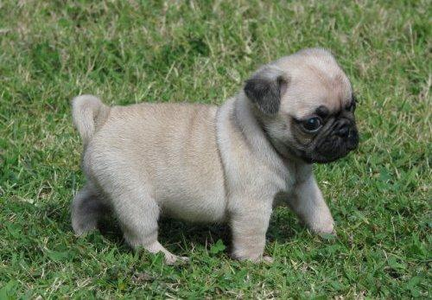
Idea 1
Make a digital repository of puppy photos
http://wotan.liu.edu/home/chromebicycle/62099892_1-home-trained-pug-puppies-for-sale-.jpg

Slide 3
Idea 2
Open all unread mail, pay your bills, keep your lights turned on for another day

Slide 4
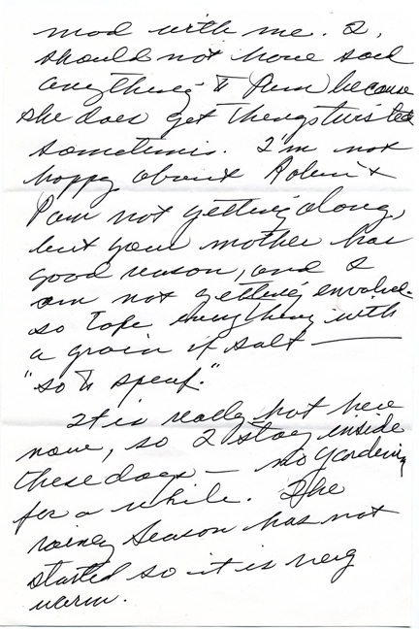
Idea 3: “Letters and Correspondence from the Collection of Kelly Marie Blanchat
Take all* my hand-written letters, scan them, and make legible with typed annotations
*much like the ability
to pay all my bills,
the time necessary to
digitize all my letters is beyond my means – but it is the eventual goal.

Slide 5
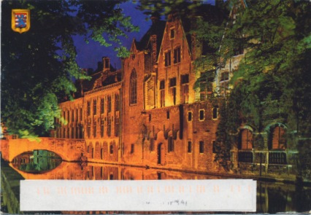
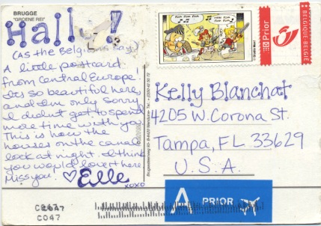
Collections & Series
The collection in my digital library will be all letters received by me, that have been unsorted and sitting in my desk for ‘x’ amount of time.
The letters are from friends & family, and will include traditional & non-traditional formats – displaying the items as they were presented in the original form.
i.e.: traditional letters, silk-screened images, matchbooks, crafted cards, etc.

Slide 6
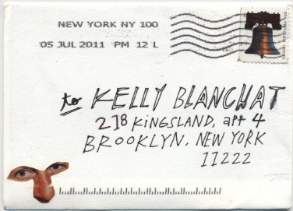
Numbers
While I have a good number of these images scanned (about 50 scans to date), I aim to post a good sampling of each ‘series’, or letters, from a variety of sources (senders), spanning 2008 – present day.

Slide 7
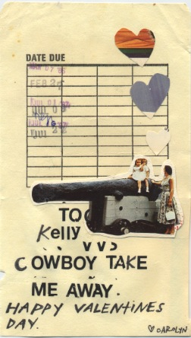
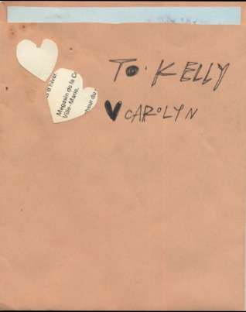
Metadata
Title – a combination of ‘creator’ and ‘date’ to distinguish the Series
Creator – people or persons who wrote the letter
Date – the date found within the body of the letter, or when not available, when the letter was postmarked on the envelope. If neither available, “undated”
Description – summary of the letter / content. If not textual, a basic description
Tags – based on specific physical and textual elements (envelope, handwritten, sender, topics)

Slide 8
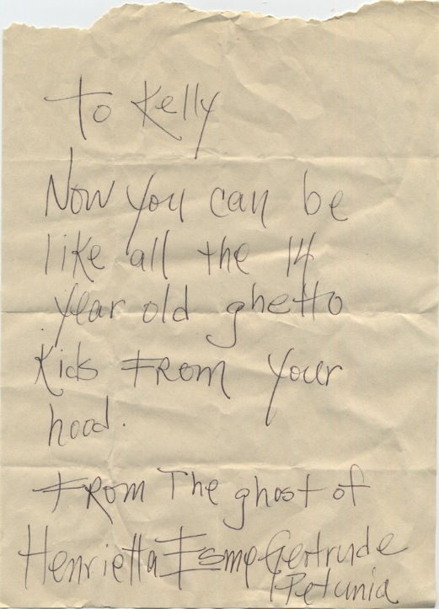
Plugins
Image Annotation – similar to how users tag elements of images in Flickr & Facebook – to enable the user to easily read handwritten text
Simple Pages – as a home page, as creator bio pages
CSV Uploader – to make life easier
…maybe others

Slide 9
Questions in progress
I have 2 collections on my site currently. They are chronological because I created the ‘collection’ chronologically. If I create a collection that back-dates the other Collections, will Omeka organize them, or will they be displayed in the order created – or can I arrange them myself (with CSS, perhaps)?
Can I create sub-series with Omeka? i.e.: can I make a Collection for “Nanny” (my grandmother) and have sub-collection for each letter received?
My CSV files are created with the last file first so that they display first to last on my Omeka Page. This works UNLESS the user clicks on the Series title instead of “view items in...” this is very Annoying – can this be fixed (with CSS)?

Slide 10
Ok, that’s it.
Best regards,
Kelly Marie Blanchat
http://wotan.liu.edu/omeka/chromebicycle/

