Slide 1
Digital Repository
Judith Schwartz
Fall 2011

Slide 2
About the collection
Will include thirty printed magazine ads focusing on “Cause Marketing” campaigns from the 1990s.
Explores the trends of corporate “socially responsible” advertising
The collection is based on research for my thesis compiled from over 200 articles, books and company websites as well as interviews.
Includes examples of controversial marketing and marketing criticized as being exploitative.
“American corporations give away seven billion dollars each year to a variety of nonprofit organizations with the hope of improving their public image…” Excerpt from “Looking Good & Doing Good” Jerome L. Himmelstein, 1997 Indiana University Press

Slide 3
Who Will Use The collection?
Individuals researching the social, cultural, and historical impact of cause marketing and advertising.
Students
Ad agencies
Company marketing depts.
Non-profits, researching company/cause partnerships

Slide 4
Growth Potential
Historical representation of “Cause Marketing” campaigns, 1960s thru present.
Exhibits might be divided into 3 groups: (using the plugin exhibit builder)
Niche Marketers: “grass roots values”
Image Builders: rebuilding a corporate image due to tarnished reputation
Passion Branders: They raise money and are involved in their causes.
Future collections may include:
TV commercials (moving images/video)
Public Interest ads

Slide 5

Additional Features
ABOUT PAGE
Description of the digital library contents and significance.
Link to my CV, contact info, and website.
Link to my research article published in “Citizen Designer” based on my masters thesis: “Socially Responsible Advertising: Altruism or Exploitation?” by Judith Schwartz.
http://www.amazon.com/Citizen-Designer-Perspectives-Design-Responsibility/dp/1581152655
Citizen Designer, perspectives on design responsibility ©2003 Steven Heller and Veronique Vienne

Slide 6
Additional Features
Textual materials:
recommended articles
links to books through Worldcat (or Amazon)
list of “Do Good” company tag lines and links to ads
Glossary of terminology such as “green washing” etc.
Interviews
Links to Academic Lib guides
includes resources such as books, articles
lists databases
Links to archives that specialize in advertising collections
Links to special media collections in the LOC

Slide 7
Access and Intellectual Rights
Rights Management, Copyright, and Usage.
(Terms of Service Plug-in creates a Policy Page)
Fair Use: U.S. copyright office
Section 107 contains a list of the various purposes for which the reproduction of a particular work may be considered fair, such as criticism, comment, news reporting, teaching, scholarship, and research.
Example, Duke University Libraries: The ads digitized as part this project were published after 1923. Therefore, the majority of ads represented in this resource are not in the public domain. The advertisements may be viewed and printed out by anyone for research, teaching, private study, or general interest.

Slide 8
Special Capabilities
Omeka Plugins will include:
Simple Pages
Light box
Exhibit Builder
Simple Contact Form
Terms Of Service

Slide 9
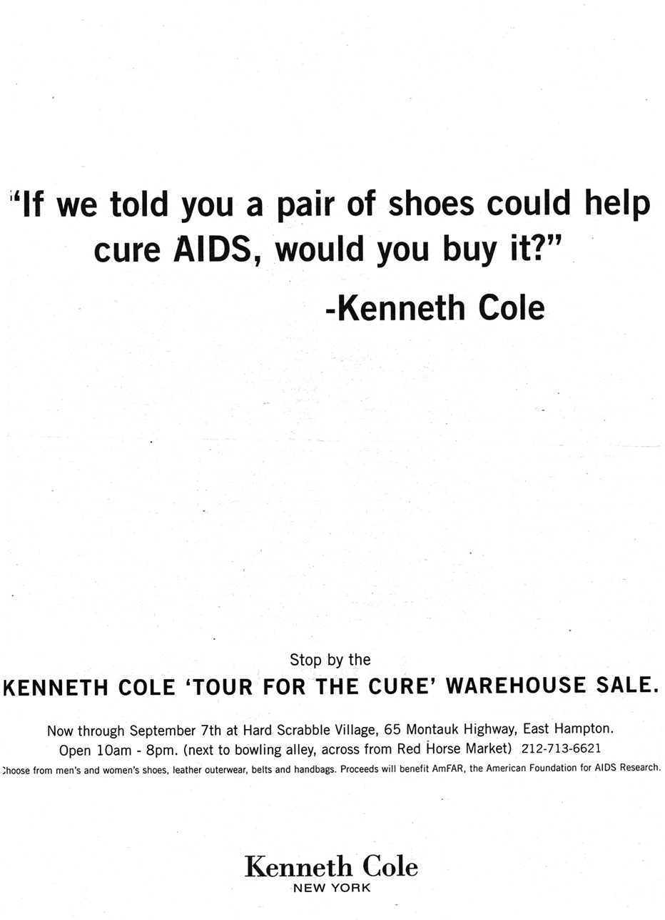
tags
Examples
Generic tags may include:
diversity, human rights, cancer awareness, girl power, disabilities, children’s issues, women’s issues, hunger, homeless, AIDS.
Fashion, automotive, footwear, food, fuel
OR
Specific tags include:
(company name, cause, date)
Kenneth Cole, Aids, Amfar, American Foundation for Aids Research, 1990s

Slide 10
Metadata /Dublin Core
Creator: ad agency
Date: YYY-MM-DD
1996-00-00
Description: Kenneth Cole promotes AIDS awareness and donates a portion of their retail sales to the AmFAR organization.
Source: scanned from magazine print ad (scanned magazine ads, company websites, marketing materials)
Format: image/jpeg

