Slide 1
Disfigured Posters
Map and record acts of creative vandalism on subway ads

Slide 2
Poster Boy
Turns MTA stations into public galleries
hopes to start a “decentralized art movement”
No copyright, no authorship
“…a social thing, as opposed to being an artist making things for bored rich people to hang above their couch.”
Is cultural criticism and social protest inherent to poster vandal art?

Slide 3
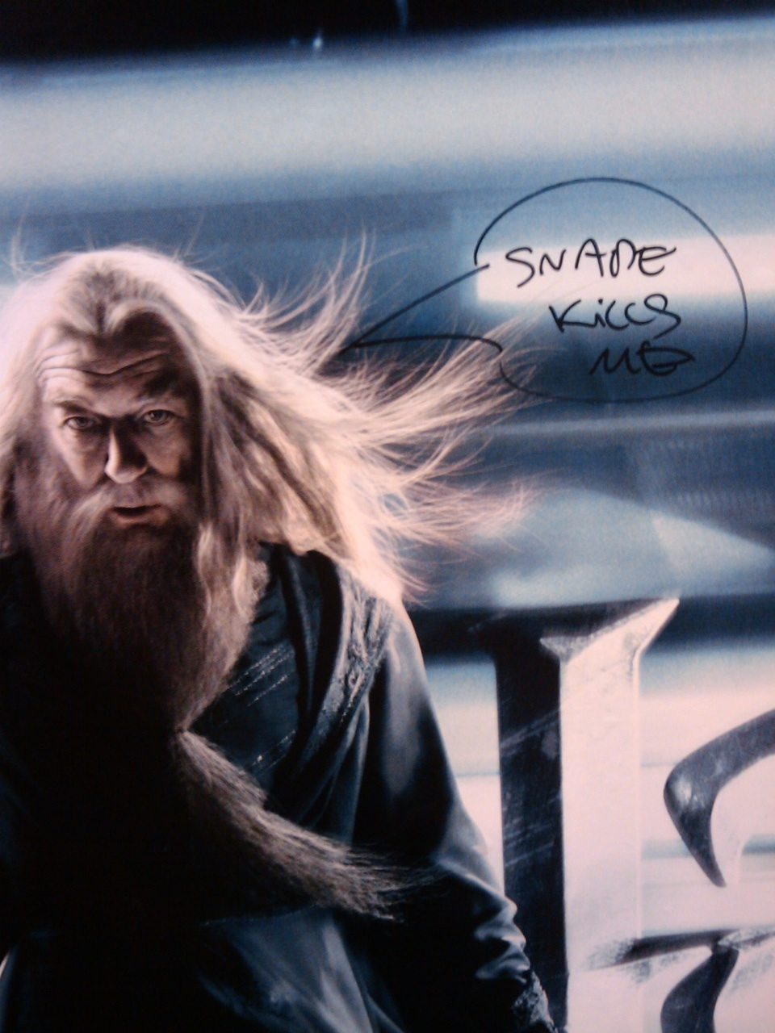
Item type: still images (often with text)
I hope to capture
15-20 images
as widely dispersed
as possible throughout
the subway system

Slide 4
Metadata
DC fields that seem most relevant include: contributor, date, location, publisher, subject, title.
Item type specific fields include: original format, physical dimensions. However, I’m not convinced these are relevant in this case.

Slide 5
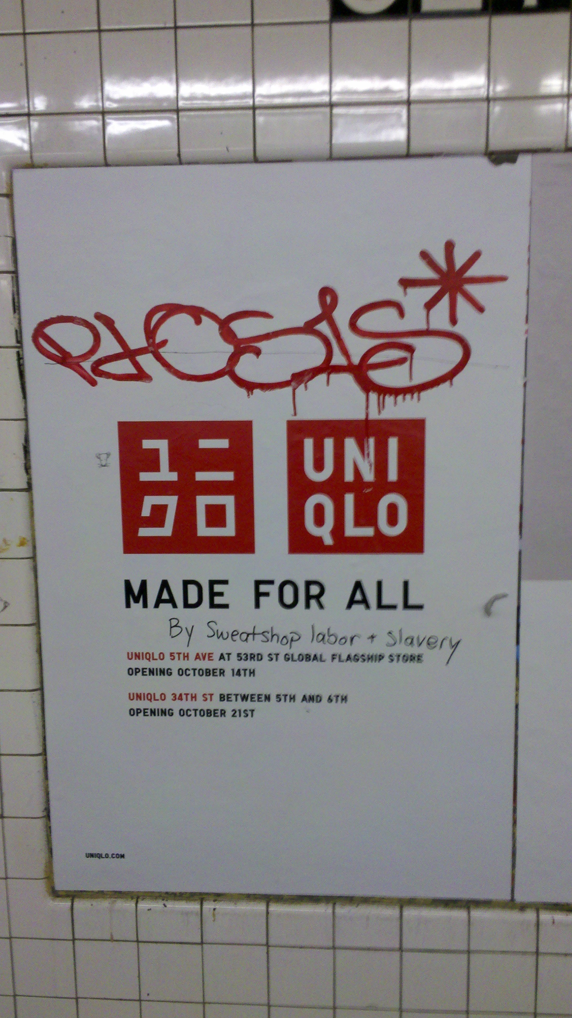
Tags:
Based on original content of the ad and subject matter contributed by artist-vandal.
Descriptive of the materials used.
Possible tags would
Include <Sweatshop>
<slavery><retail>
<chain><Uniqlo>

Slide 6
Plug-ins:
Image annotation: to ensure readability of any text, or to provide context.
Geolocation: designating where in the subway system the vandalized ad was found (note: NOT where ad can currently be found).
Contribution: ideally it would be great if any commuter could contribute photographs of altered posters that caught their attention mid-commute.

