Slide 1
Marketing "Radical"
A collection of YA-Targeted Advertising in Disney Adventures Magazine, 1995

Slide 2
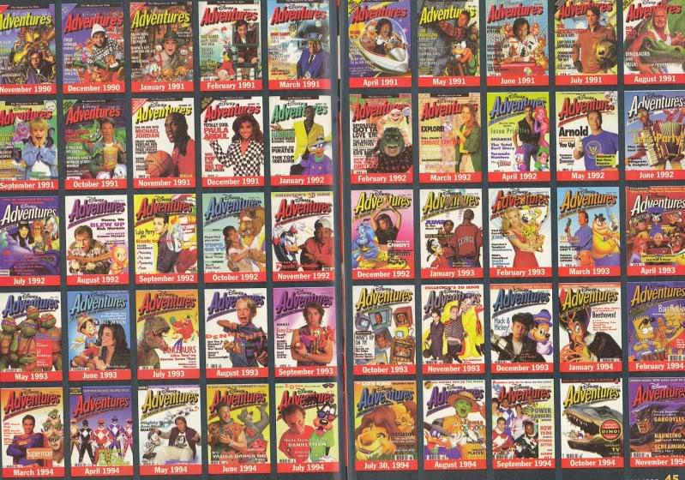
Disney Adventures Magazine
Image source: http://www.toonzone.net/forums/showthread.php?222357-The-Disney-Adventures-Archive&p=3246524#post3246524

Slide 3
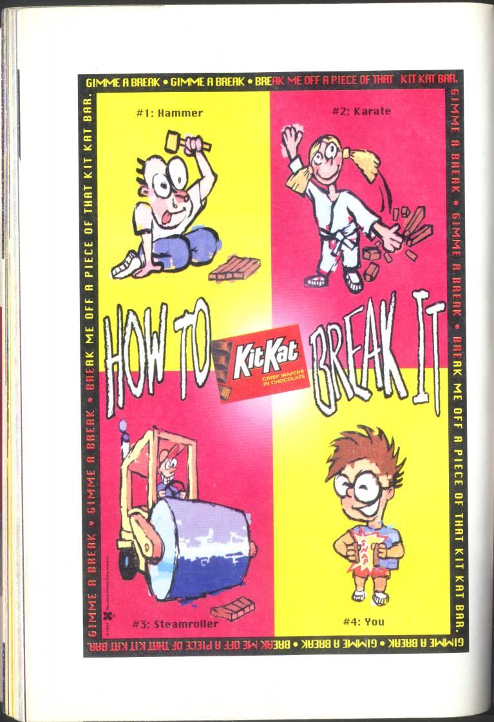
The Advertising
13x19 cm
.png or .jpg
DA1995-6-01-38

Slide 4
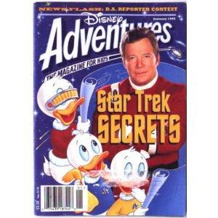
Potential Metadata Fields
Title: two possible components
  Filename: Short format source
  Identifier: Name of product/service
Subject: Product/service type
Description: details product/service advertised, contents of image.
Type: Image.
Source: long format
Relation: IsPartOf
Creator, Publisher, Rights, Date, Format

Slide 5
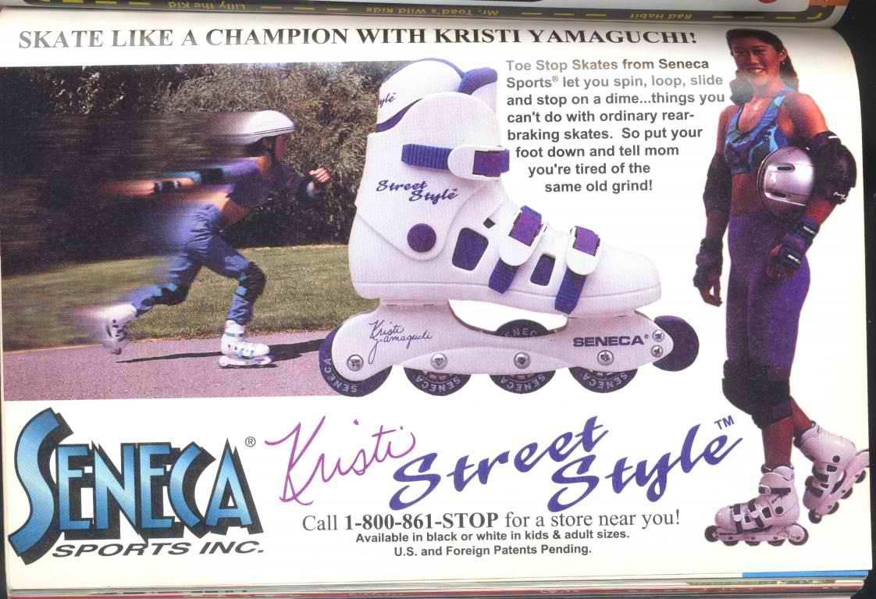
DA1995-6-02-51

