Slide 1
Central Park Benches

Slide 2
Adopt-A-Bench
Established in 1986 as way to maintain and care for Central Park's more than 9,000 benches and their surrounding landscapes.
To date, more than 2,000 benches have been adopted.

Slide 3
Recognition:
After the donation the park installs a plaque engraved with a personalized inscription on a park bench in a location of the donor's choosing.
Most benches can be adopted for $7,500. Contributions of $25,000 are recognized with a plaque on a hand-made rustic bench in an area chosen by the donor.

Slide 4
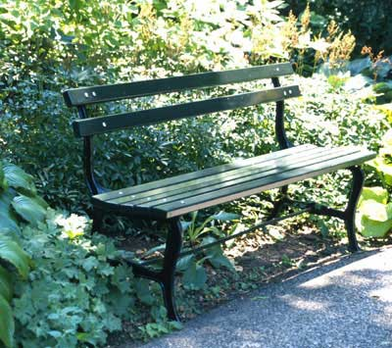
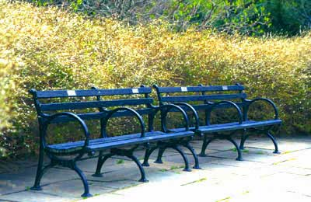
Item type: different kinds of benches
Central Park Settee : simple, unobtrusive design of the historic benches originally used in the Park
World’s Fair Bench : more ornate wood and cast iron bench with circular armrests in more formal areas of Central Park, such as plazas.

Slide 5
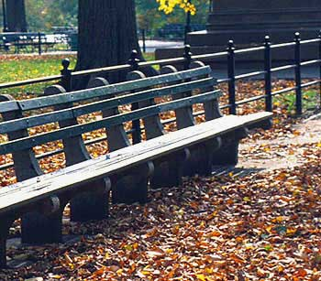
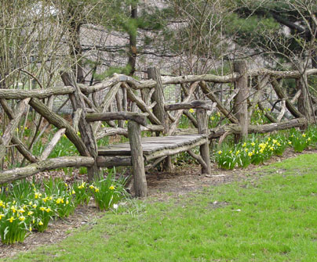
Type of benches continued
Wood and Concrete Benches: durable, immovable benches, it can be found in locations throughout the Park, and is the bench type consistently used in playgrounds and along the park perimeter
Rustic Benches: These hand-crafted benches are found in the Park's woodlands and other picturesque settings; usually made of locust or cedar, each design is unique.

Slide 6
DC Fields
Title
Description
Coverage
Format
Identifier

Slide 7
Plugin
Geolocation: to show where each bench is located

Slide 8
Tags:
Each picture of the adopted benches will have
different tags
Types of inscription
Park section (e.g. Sheep’s Meadow)
Type of bench

