Slide 1
Building Digital Libraries
Project Presentation
By Tania Silva
LIS 654
Dr. Thomas Krichel

Slide 2
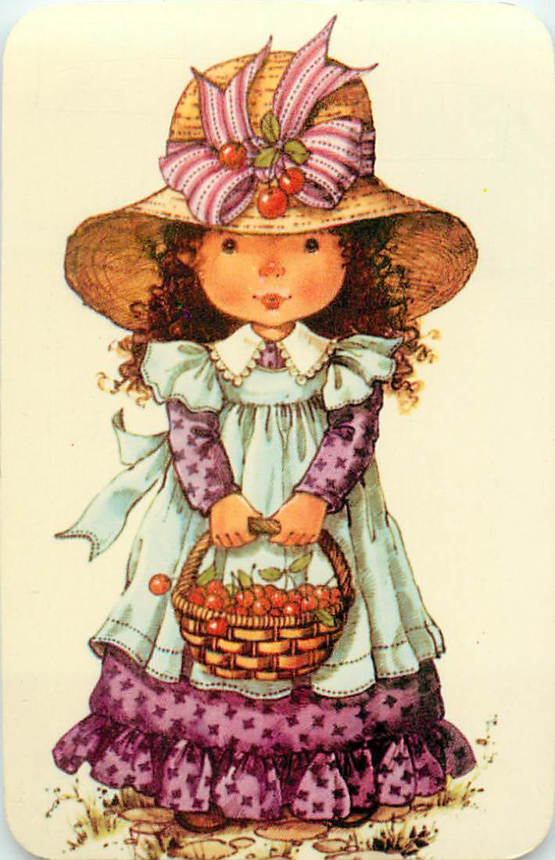

Collectible Pocket Calendars

Slide 3
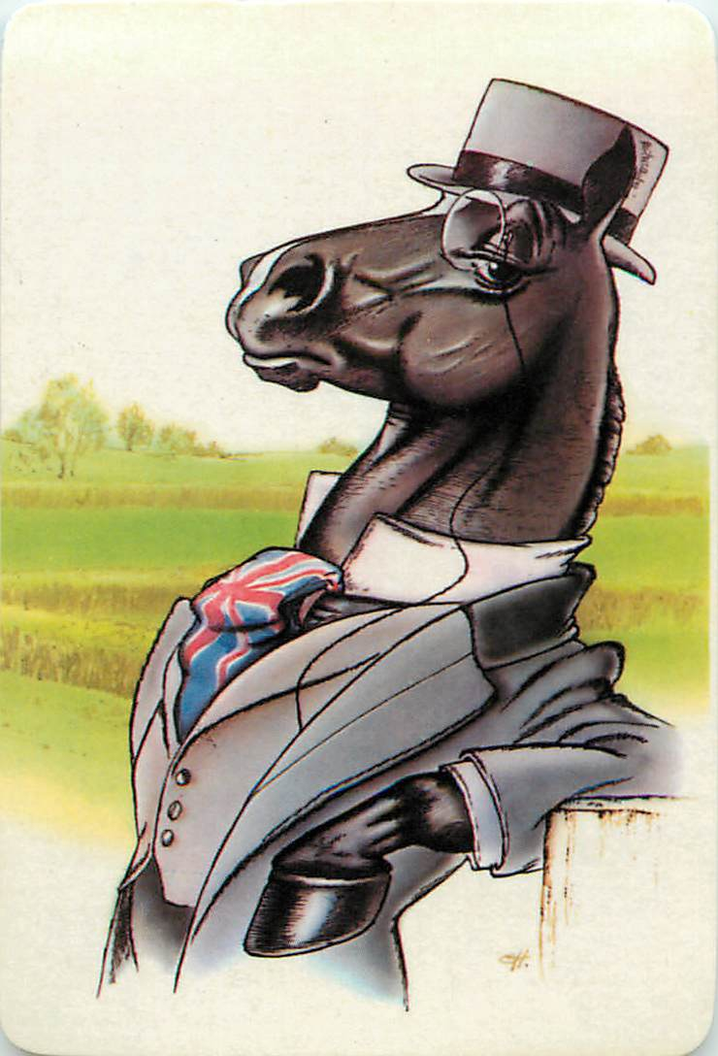
Audience
The digital library will primarily, but not exclusively, be aimed at users who:
  Enjoy collecting pocket calendars
  Would like to add their own pocket calendar to an incomplete collection

Slide 4
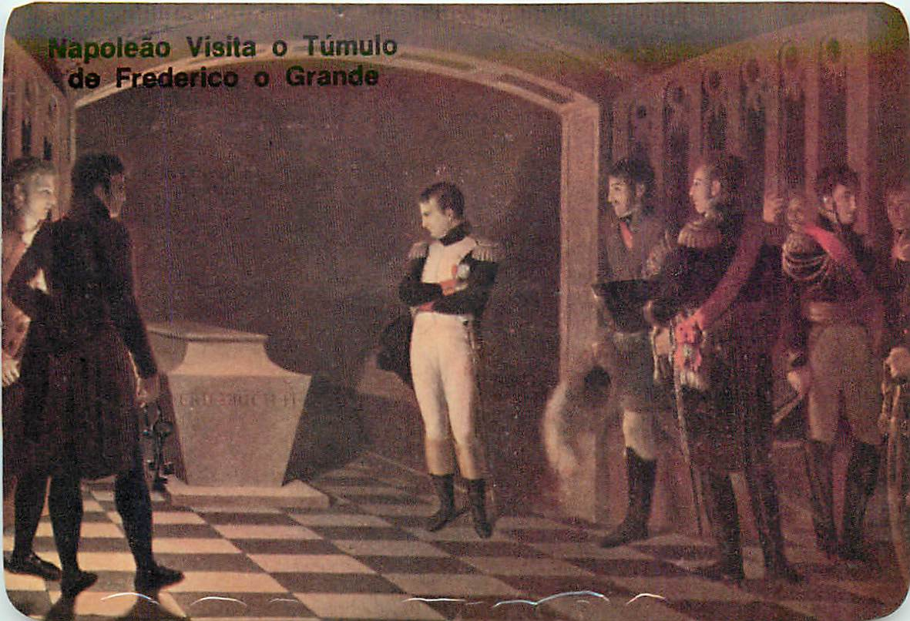
Purpose
The purpose of this digital library will be:
  To show the different collectible pocket calendars that were being collected in Portugal in the late 1980’s.

Slide 5
Collections
There will be at least 5 collections, if not more.
Each collection will consist of JPG’s of scanned pocket calendars.
The amount of JPG’s in each collection will vary, anywhere from 5 to 12 per collection.
These pocket calendars are from my own collection as a child.

Slide 6
Plugins
Exhibit Builder will be the main plugin because it allows for pictures and narrative text, in addition to being able to add as many sections and pages as necessary for each exhibit.

Slide 7
Item Type & Metadata
Tags
Still Image – all the scanned calendars in JPEG from my personal childhood collection with the following:
Title
Subject
Date
Object Type
Collection
Collection Website
Format
Image Number
Animated Animals
Soccer Players
Transportation
Carton Characters
Dogs
Birds
Butterflies
FIFA World Cup

Slide 8
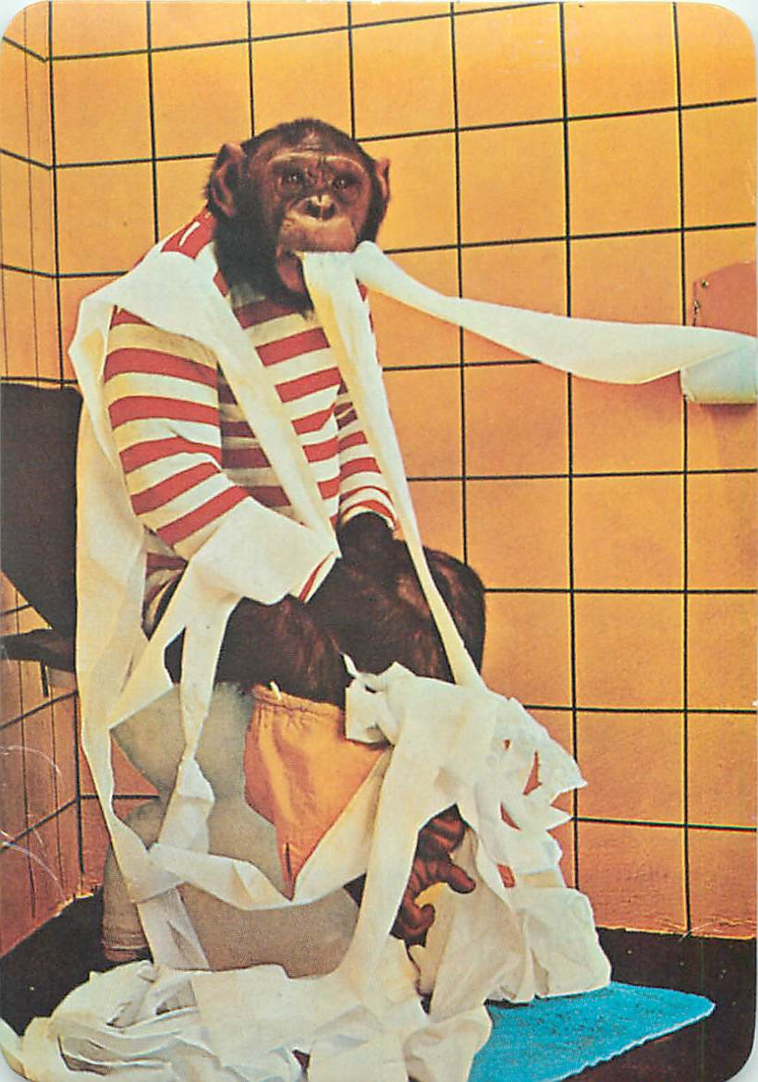
The End.

