Slide 1
Image Annotation Plugin for Omeka
Mikhail Livshits

Slide 2
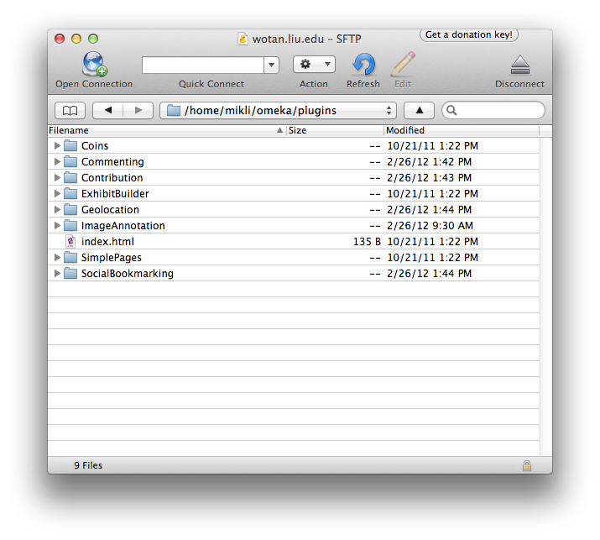
Install
Download the plugin at http://omeka.org/add-ons/plugins/image-annotation/
Upload folder to /omeka/plugins

Slide 3
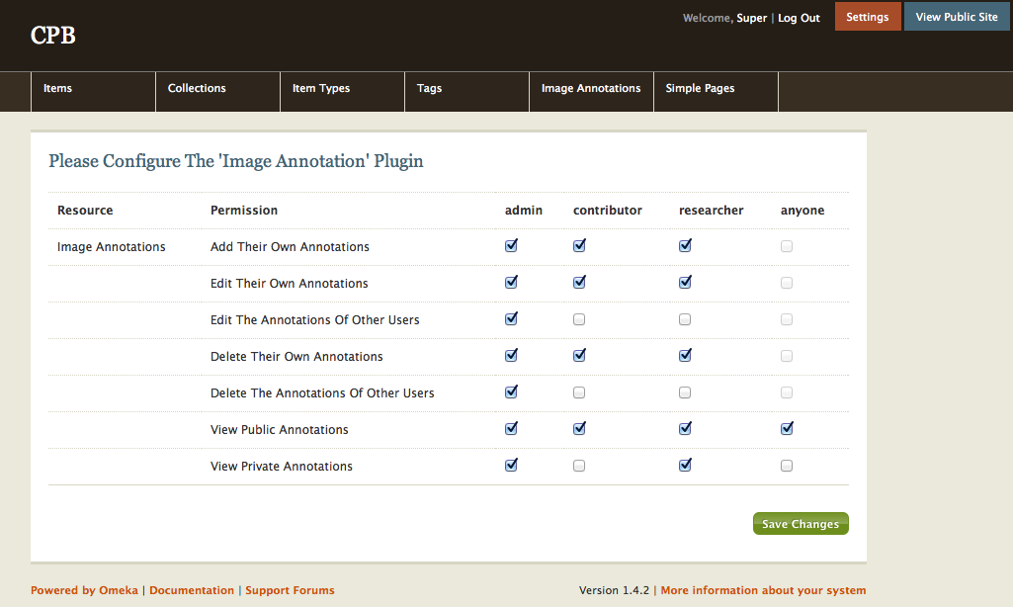
Configure
Log in to Omeka Admin → Manage Plugins → Configure (next to Image Annotation
Set permissions

Slide 4
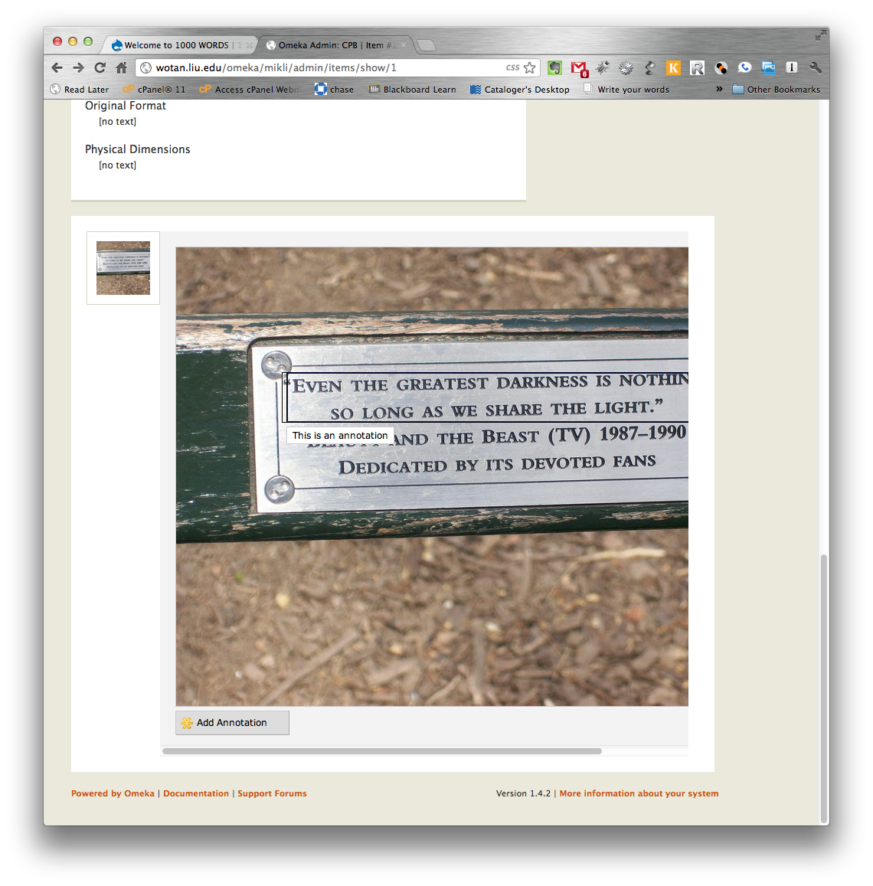
Use
If you are an authorized user, every image in the collection will have an “Add Annotation” button under it.
Select the area of the image you would like to annotate and type your annotation.
Click on existing annotations to edit or delete.
Users will see your annotation when they mouse over the area you selected.

