Slide 1
Assessing a human mediated current awareness service
International Symposium of Information Science (ISI 2015) Zadar, 2015-05-20
Zeljko Carevic¹, Thomas Krichel² and Philipp Mayr¹
¹firstname.lastname@gesis.org
²lastname@openlib.org

Slide 2
Outline
Slide 2 / 31
Introduction
RePEc and NEP
Results
3.1 Editing time
3.2 Indicators for report success
3.3 Editing effort
Conclusion and Outlook

Slide 3


Motivation
Slide 3 / 31
Thomas Krichel, the founder of RePEc, visited GESIS – Cologne in Oct. 2014
Sharing his Russian souvenir
~100 GB of XML log files

Slide 4
1. Introduction
Slide 4 / 31
Current awareness in digital libraries
To inform users / subscribers about new / relevant acquisitions in their libraries [1].
Current awareness services allow subscribers to keep up to date with new additions in a certain area of research.
Selection of relevant documents can be done (semi-)automatically or manually.
For this work we focus on the intellectual editing process
Aim of this work:
How do editors work when creating a subject specific report in Digital Libraries (DL)?

Slide 5
2. Use case: RePEc
Slide 5 / 31
RePEc (Research Papers in Economics) is a DL for working papers in economics research.
Covers metadata for working papers and journal articles.
Usually document metadata contains links to full texts

Slide 6
2. RePEc statistics
Slide 6 / 31
Contr. Archives | Documents | Full text Documents | Regist. Authors | Abstract views (April 2015)
~1,700 | 1.77 mio | 1.63 mio | ~45,000 | >2 mio

Slide 7
2. Current awareness service NEP
Slide 7 / 31
NEP (New Economics Papers) is a current awareness service for new additions in RePEc.
NEP covers subject specific reports from over 90 specific fields.
Business, Economic and Financial History
Public Economics
Social Norms and Social Capital
Issues are sent to subscribers via E-Mail, RSS and Twitter
Reports to new additions are generated by subject specific editors.
Relevant document selection is done manually by the editor!

Slide 8


Slide 8 / 31
Contains all new RePEc docs
Created roughly on weekly base
Contains avg. 488 doc
Nep-all
Notified
Notified
Notified
Notified
Manual selection of relevant documents is a time consuming task.
Selects
Selects
Selects
Selects
Nep-acc
Nep-afr
Nep-upt
Nep-ure
Sends issue
Sends issue
Sends issue
Sends issue

Slide 9
ERNAD
Slide 9 / 31
ERNAD (Editing Reports on New Academic Documents) is a purposed built system
Re-rank nep-all for each editor based on the specific report topic
Looking at past issues of a report to produce a ranked nep-all
If presorting works well editors select highly ranked documents from nep-all

Slide 10
ERNAD example for Nep-Africa (NEP-AFR)
Slide 10 / 31
Nep-all unsorted
Nep-all presorted
1. Tax compliance..
2. Mental accounting..
…
212. Ethnic ..in Africa
317. Sino-African relations:
1. Ethnic ..in Africa
2. Sino-African relations:
…
50. Tax compliance..
51. Mental accounting..

Slide 11

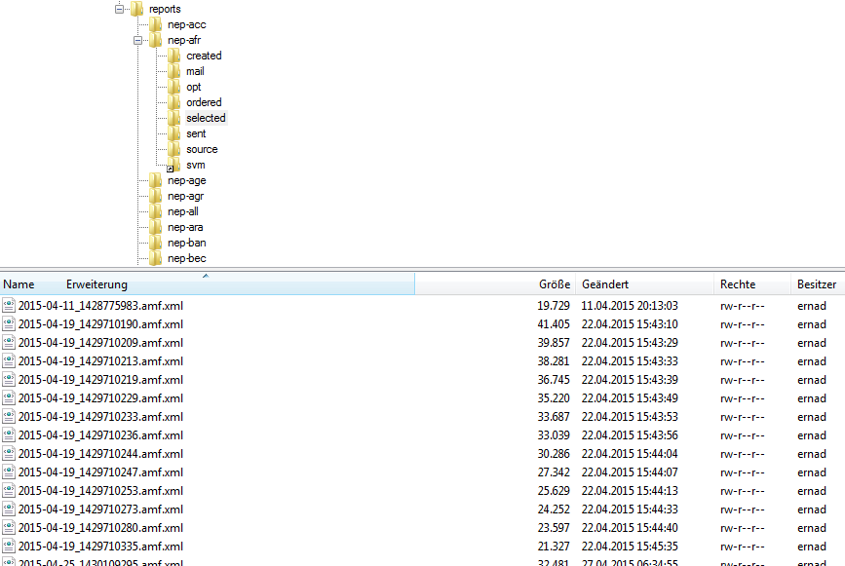
Editing stages
Slide 11 / 31

Slide 12
Research questions
Slide 12 / 31
RQ 1: How long is the editing duration?
RQ 2: What influences the success of a report?
Editing duration
Issue size
RQ 3: How much effort is invested for selecting and sorting papers per issue?
Precision @ N
Relative search length

Slide 13
RQ 1: Editing time
Slide 13 / 31
How much time do editors invest to create a report?

Slide 14
Pre-selection
Slide 14 / 31
Editing an issue can be interrupted
This would distort the results
Exclude interrupted issues by separating the edit duration in 3-minute chunks

Slide 15
Pre-selection
Slide 15 / 31
Limit edit time < 90 min

Slide 16
RQ 1: Editing time
Slide 16 / 31
Max. 53 minutes NEP-ETS (Economic time series)
Avg. 15.5 minutes. (sd = 10.1)
Min. 2.5 minutes NEP-RES (Resource economics)

Slide 17
Summarize RQ 1
Slide 17 / 31
Average editing time is comparable low with 15.5 minutes
Huge scattering between the reports:
Min. 2.5 minutes
Max. 53 minutes

Slide 18
RQ 2: Influences to successful reports
Slide 18 / 31
Popularity of a report can be measured by the number of subscribers.
Huge scattering between number of subscribers per report
Max. 6859 NEP-HIS Business, Economic and Financial History
Min. 75 NEP-CIS Confederation of Independent States
Factors influencing reports success for example: topic, age of a report..
Does the issue size or the editing time influence the report success?

Slide 19
Editing time
Slide 19 / 31
Education
2198 sub. (avg. 836)
Project, Program and Portfolio Management
43,5 min (avg. 15.5)

Slide 20
Issue size
Slide 20 / 31
Sports issue size 2.5
(avg. 12.4)
Demographic Economic
issue size 21
(avg. 12.4)

Slide 21
Summarize RQ 2
Slide 21 / 31
There is no correlation between:
Issue size and number of subscribers
Editing time and number of subscribers
We assume that the success of a report is mainly driven by topic and age.

Slide 22
RQ 3: Effort in selecting and sorting
Slide 22 / 31
How much effort is invested in selecting and sorting relevant documents from nep-all?
Two measures are used:
Precision @N
Relative search length

Slide 23
Precision @ N
Slide 23 / 31
How many of the top n documents from pre-sorted nep-all are selected for the issue?
N set to: 5, 10, 15, 20
We only consider issues where issue size > N
A document is relevant if its index position in nep-all is < N.

Slide 24
Example: P@ 5
Slide 24 / 31
M={(D1, 4), (D2, 1), (D3, 7), (D4, 3), (D5, 9)}
P@5 for issue I in report J = ⅗
Editors vary between using pre-sorted and un-sorted nep-all. Therefore:
Only consider issues with pre-sort usage > 50

Slide 25
Results for P@N
Slide 25 / 31
Avg. P@5 (82 rep) | Avg. P@10 (64 rep) | Avg. P@15(50rep) | Avg. P@20 (31 rep)
0.77 | 0.80 | 0.80 | 0.82
Max. found for nep-env (Environmental Economics) with P@5 = 0.99
Min. found for nep-cba (Central Bank) with P@5 = 0.35

Slide 26
Summarize P@N
Slide 26 / 31
Editors work comfortably with the presorting in nep-all.
The number of papers per issue has no significant influence for the precision.

Slide 27

Relative Search Length
Slide 27 / 31
We know how many of the top N document from nep-all selected.
To what depth do editors inspect nep-all?
Ratio between the highest index position (hin) of the last relevant document in nep-all and the length of nep-all

Slide 28
Example RSL
Slide 28 / 31
Editor is given a nep-all containing 300 documents.
M={(D1, 4), (D2, 10), (D3, 7)}
RSL = 10/300
We assume that the editor has inspected nep-all to document 10.

Slide 29
Relative Search Length
Slide 29 / 31
NEP-MAC (Macroeconomics)
RSL = 0.35
Avg. RSL = 0.08
NEP-SPO
(Sports and Economics)
RSL = 0.01

Slide 30
Summarize RSL
Slide 30 / 31
The relative search length is comparable low with 0.08
Editors select papers from the very upper part of nep-all.

Slide 31
Conclusion
Slide 31 / 31
Focused on observable system features
Editing time
Influences on report success
Effort in creating an issue
Summarize: The system supports the editor well in creating an issue
A complete view requires a more user-centred observation.
Future work:
Why and under what conditions is a document relevant?
NEP provides many opportunities for further research on data that is relatively easily available.

Slide 32
Thank you!
Questions?

